Slide 1
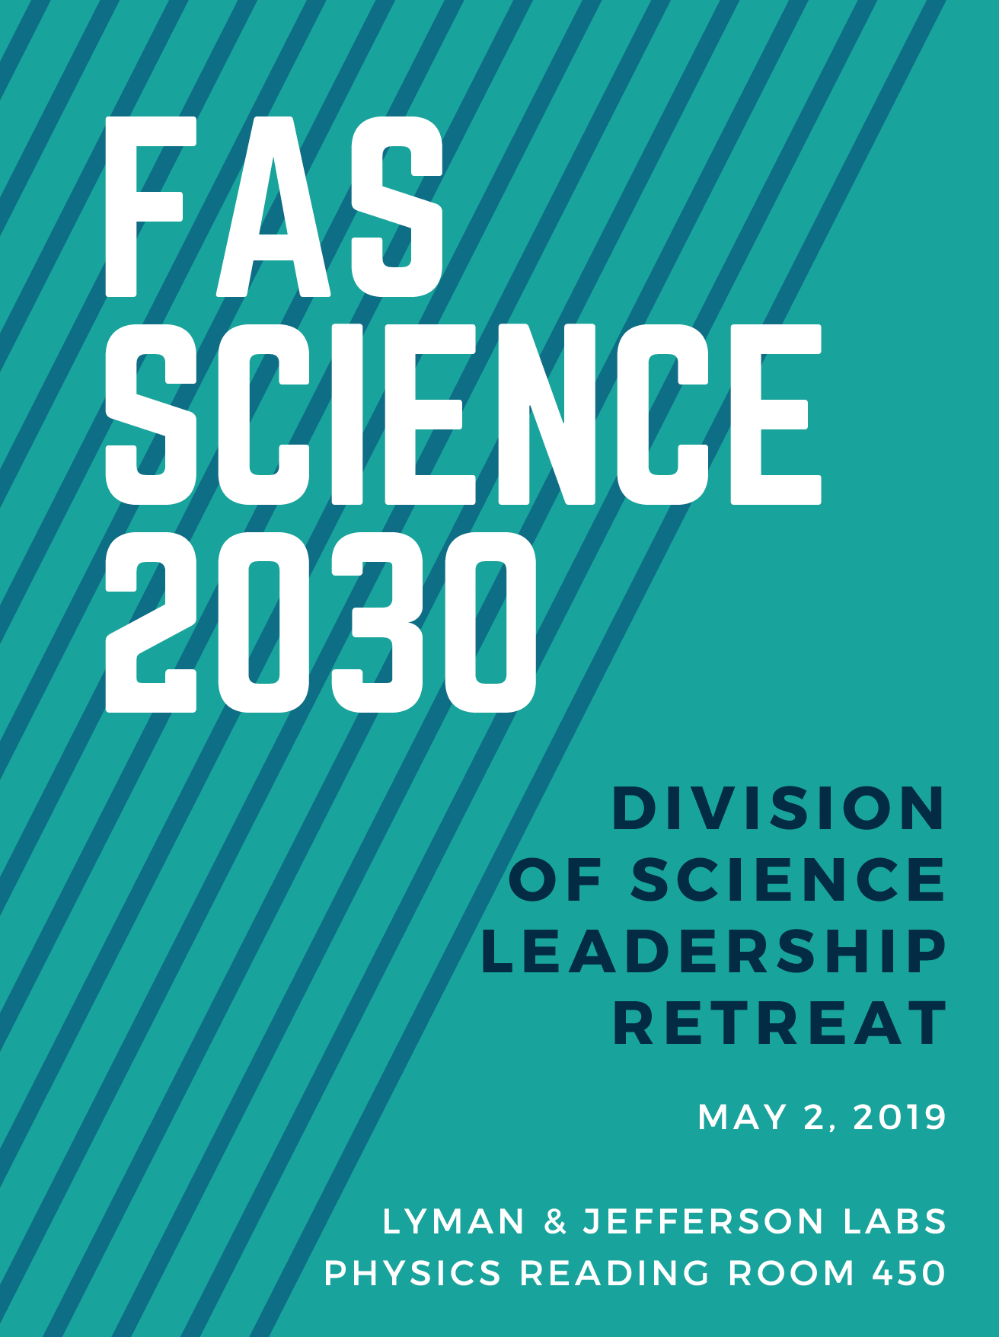
WELCOME

Slide 2
FAS Science Division 2030
Strategic Planning Retreat
May 2, 2019
The purpose of this meeting is to bring together divisional staff, administrators, and faculty to initiate a strategic planning discussion, and to explore how the science division should evolve over the coming decade to meet our institutional goals.
The data tools we are using today for our exercises are anonymous

Slide 3
 | Agenda
10:00 - 10:45 | Science Division Overview & General Q&A
10:45 - 11:00 | Break
11:00 – 12:00 | Individual and Group Strategic Planning Exercise
12:00 - 12:45 | Lunch Break
12:45 - 1:45 | Diversity, Inclusion, and Belonging Discussion and Exercise
1:45 - 2:00 | Break
2:00 - 2:45 | Breakout Group Work, Discussion and Report Out
2:45 - 3:00 | Wrap up

Slide 4
Harvard Faculty of Arts and Sciences- Division of Science
the largest academic division of Harvard’s FAS.
includes oversight of the science Interfaculty Initiatives and the Rowland Institute.
10 academic departments, 3 museums, 25 Ph.D. programs, 14 independent centers and initiatives, and wealth of academic initiatives and programs that are housed within academic departments.
Academic Departments
    Astronomy
    Chemistry & Chemical Biology
    Earth & Planetary Sciences
    Human Evolutionary Biology
    Mathematics
    Molecular & Cellular Biology
    Organismic & Evolutionary Biology
    Physics
    Statistics
    Stem Cell & Regenerative Biology**
Museums
  Museum of Comparative Zoology
  Harvard University Herbaria
  Mineralogical and Geological Museum
Centers, Initiatives, & Programs
Center for Advanced Imaging (CAI)
Center for Brian Science (CBS)
Ctr for Math Sciences and Applications (CMSA)
Center for Nanoscale Systems (CNS)
Graduate Programs for BioPhysics, SysBio, and ChemBio**
Harvard College Observatory (HCO)
Harvard Forest
Harvard Stem Cell Institute (HSCI)**
Harvard Quantum Initiative (HQI)
Harvard University Center for the Environment
John Harvard Distinguished Science Fellows
Laboratory for Particle Physics and Cosmology
Microbial Science Initiative**
Origins of Life Initiative**
Program for Evolutionary Dynamics
QuantBio
Rowland Institute
^{(**)} Interfaculty Initiatives (IFIs)

Slide 6
Academic Structure
Dean of FAS
Claudine Gay
Divisional Dean, Arts & Humanities
Robin Kelsey
Divisional Dean, Sciences
Christopher Stubbs
Divisional Dean,
Social Sciences
Larry Bobo
Undergrad Education
Logan McCarty
Science Division Faculty Advisory Group
Graduate Education
Jacob Barandes
Academic Affairs
Zoe Fonseca-Kelly
Director, Research Computing
Scott Yockel
Special Projects
Tasha Thomas
Department Chairs
Center Directors
Department Chairs

Slide 7
Actual Academic Structure!
Dean of FAS
Claudine Gay
Divisional Dean, Arts & Humanities
Robin Kelsey
Divisional Dean, Sciences
Christopher Stubbs
Divisional Dean,
Social Sciences
Larry Bobo
Undergrad Education
Logan McCarty
Science Division Faculty Advisory Group
Graduate Education
Jacob Barandes
Academic Affairs
Zoe Fonseca-Kelly
Director, Research Computing
Scott Yockel
Special Projects
Tasha Thomas
Department Chairs
Center Directors
Department Chairs

Slide 8
Administrative
Structure
Administrative Dean of FAS
Leslie Kirwan
Divisional Administrative Dean, Arts & Humanities
Divisional Administrative Dean, Sciences
Russ Porter
Divisional Administrative Dean,
Social Sciences
Space/Facilities Planning
Sharalee Field
Science Operations
Sarah Elwell
Research Development and Strategy
Susan Gomes
Divisional Office Staff
Nicola O’Shea, Tasha Thomas
Departmental Administrators
Center Executive Directors
Department Chairs

Slide 9
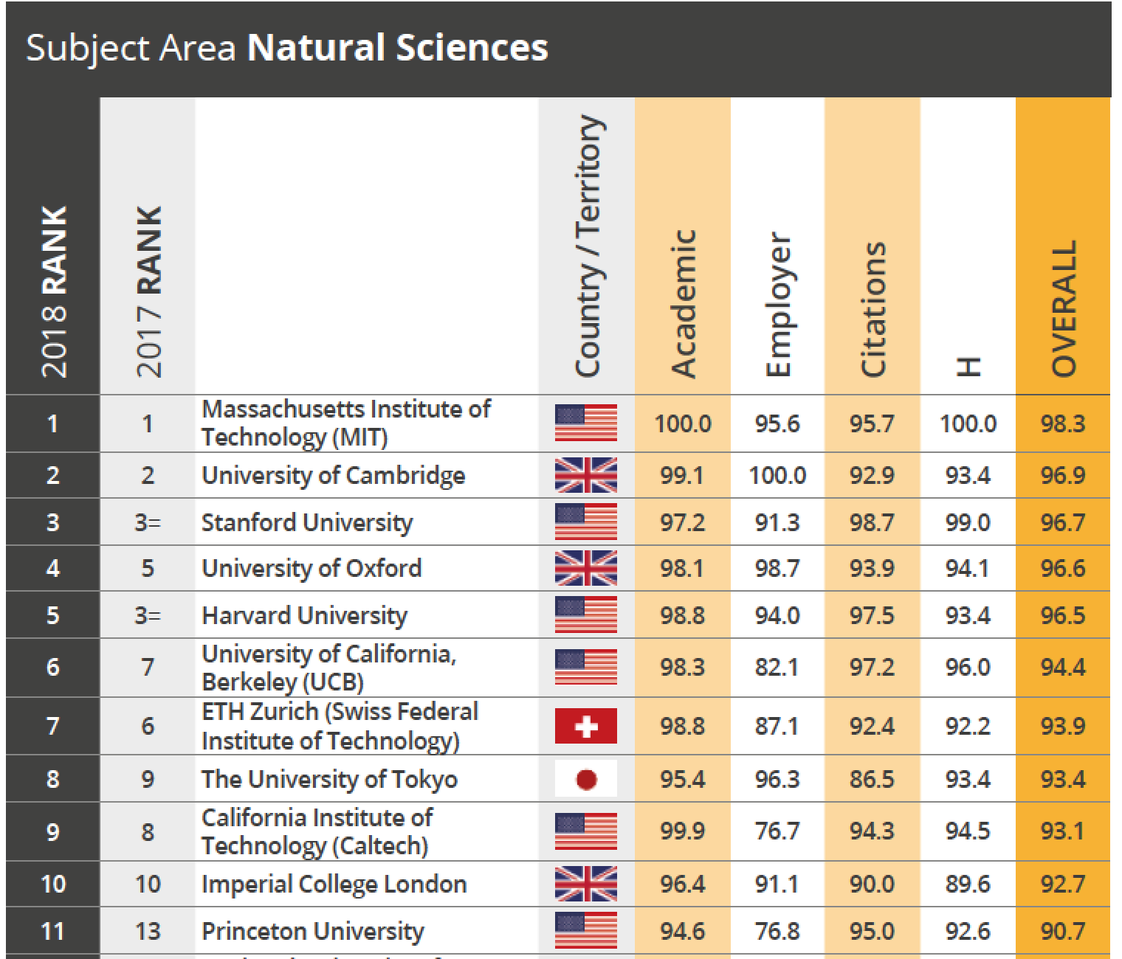
Natural Sciences
www.topuniversities.com

Slide 10
My Primary Goals for this year:
Establish strong departmental support for Harvard College curriculum (Gen Ed)
Engage faculty in divisional governance (advisory group)
Coordinated strategic space planning
    Renovation of Science Center
    Cambridge configuration after SEAS-to-Allston expansion
    Longer term perspective on facilities and infrastructure
Sustain inclusive excellence- bring best minds to Harvard, and help them thrive
Increased transparency, consultation, and communication
Support and establish two new initiatives:
    Quantitative Biology
    Quantum Science and Engineering

Slide 11
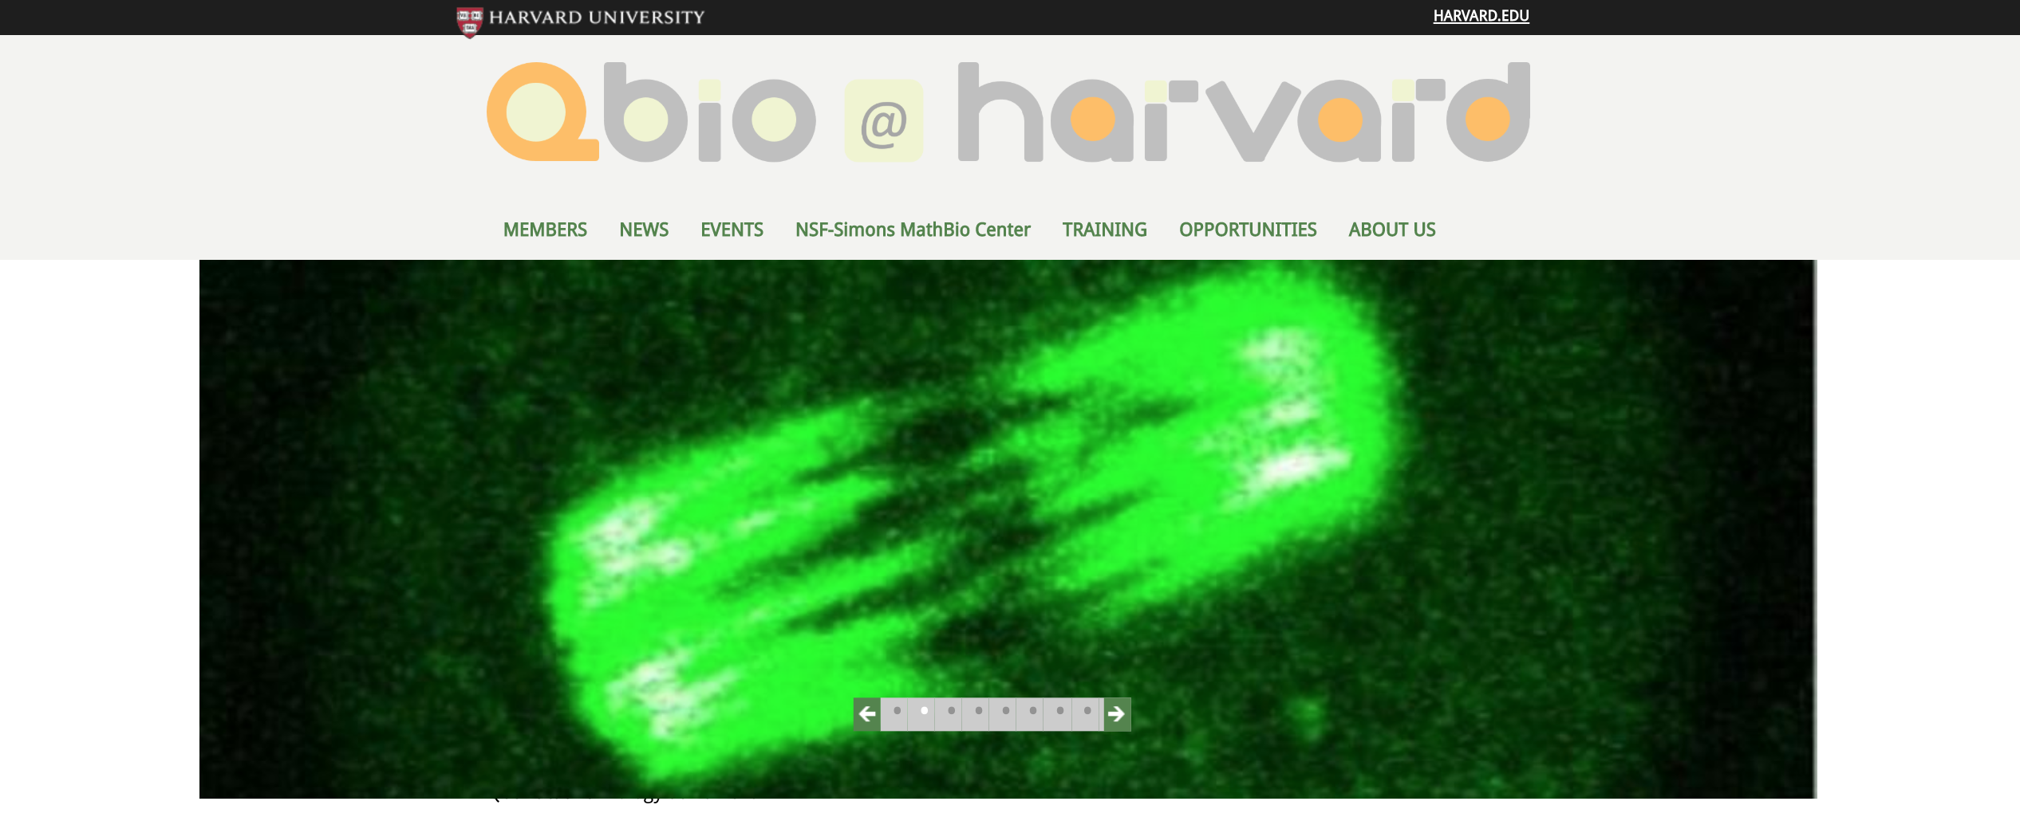
Quantitative Biology Initiative
Objective is to construct viable mathematical models for living systems.
Builds on success of FAS Center for Systems Biology, linking physical and life sciences.
Example of curricular impact- LS 50, year-long double-course for first year students that integrates mathematics, computation with introductory life and physical science.

Slide 12
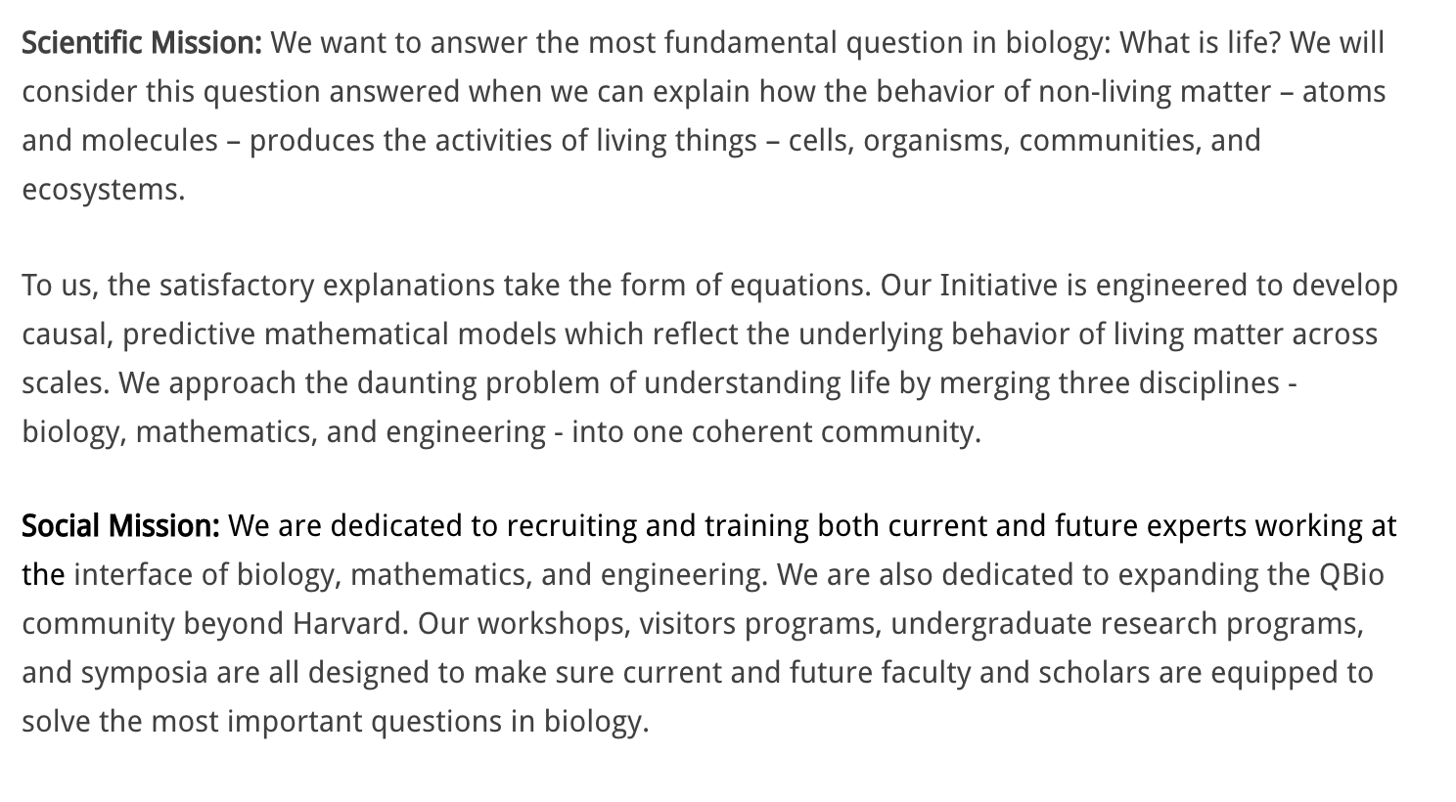
Quantitative Biology Initiative

Slide 13

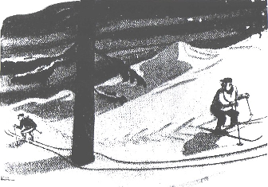
THE QUANTUM WORLD
The development of QSE will astound, confound and transform us
Superposition: objects can “be” in two places at once

Slide 14
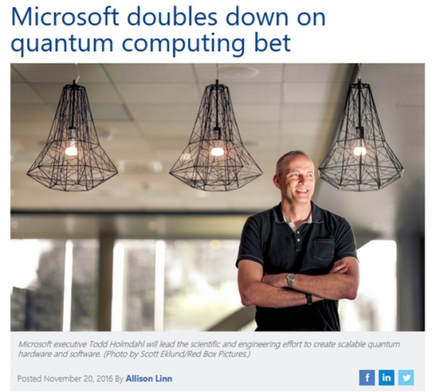
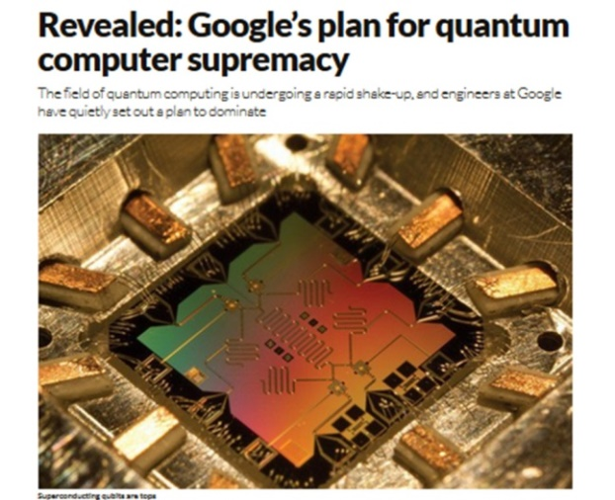

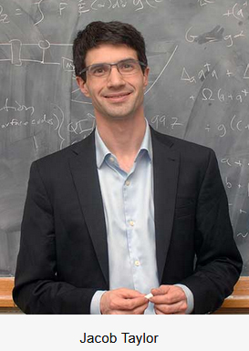
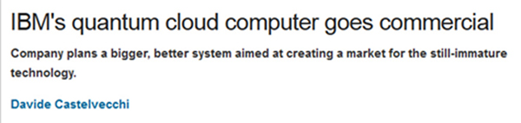
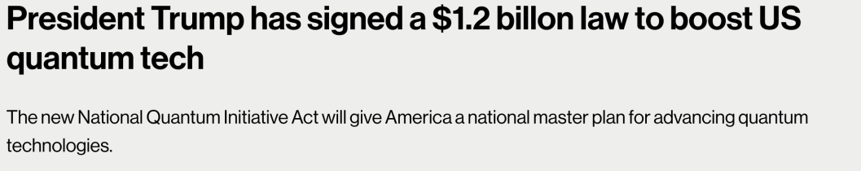
You may have heard… A “QUANTUM ARMS RACE”
21st century
quantum tech
at a global scale
Jacob Taylor
AB ’00, PhD ’06

Slide 15
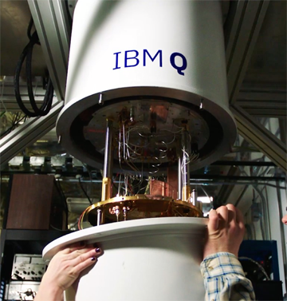

QUANTUM SCIENCE & ENGINEERING:
at its nascence
DESPITE investments in Quantum industry, we are only at the start of our scientific & engineering exploration:
How can we engineer large-scale Quantum Machines ?
How can we “speak to” and “control” those systems (e.g. algorithms)?
What are the practical applications for
  Quantum Computers
  Quantum Sensors
  Quantum Communication Systems?
What new materials, engineering innovations need to be developed?
What new insights, skills, tools will be needed to sustain innovation in QSE?
HQI

Slide 16
Excellent People – our most important asset
Faculty: 442
    205 Ladder
    82 Non-ladder
    5 Visiting faculty
    150 Research Associates
Staff: 741
    309 Exempt
    432 Non-exempt
Postdocs: 755
Graduate students: 985
Undergraduate concentrators: 1735

Slide 17
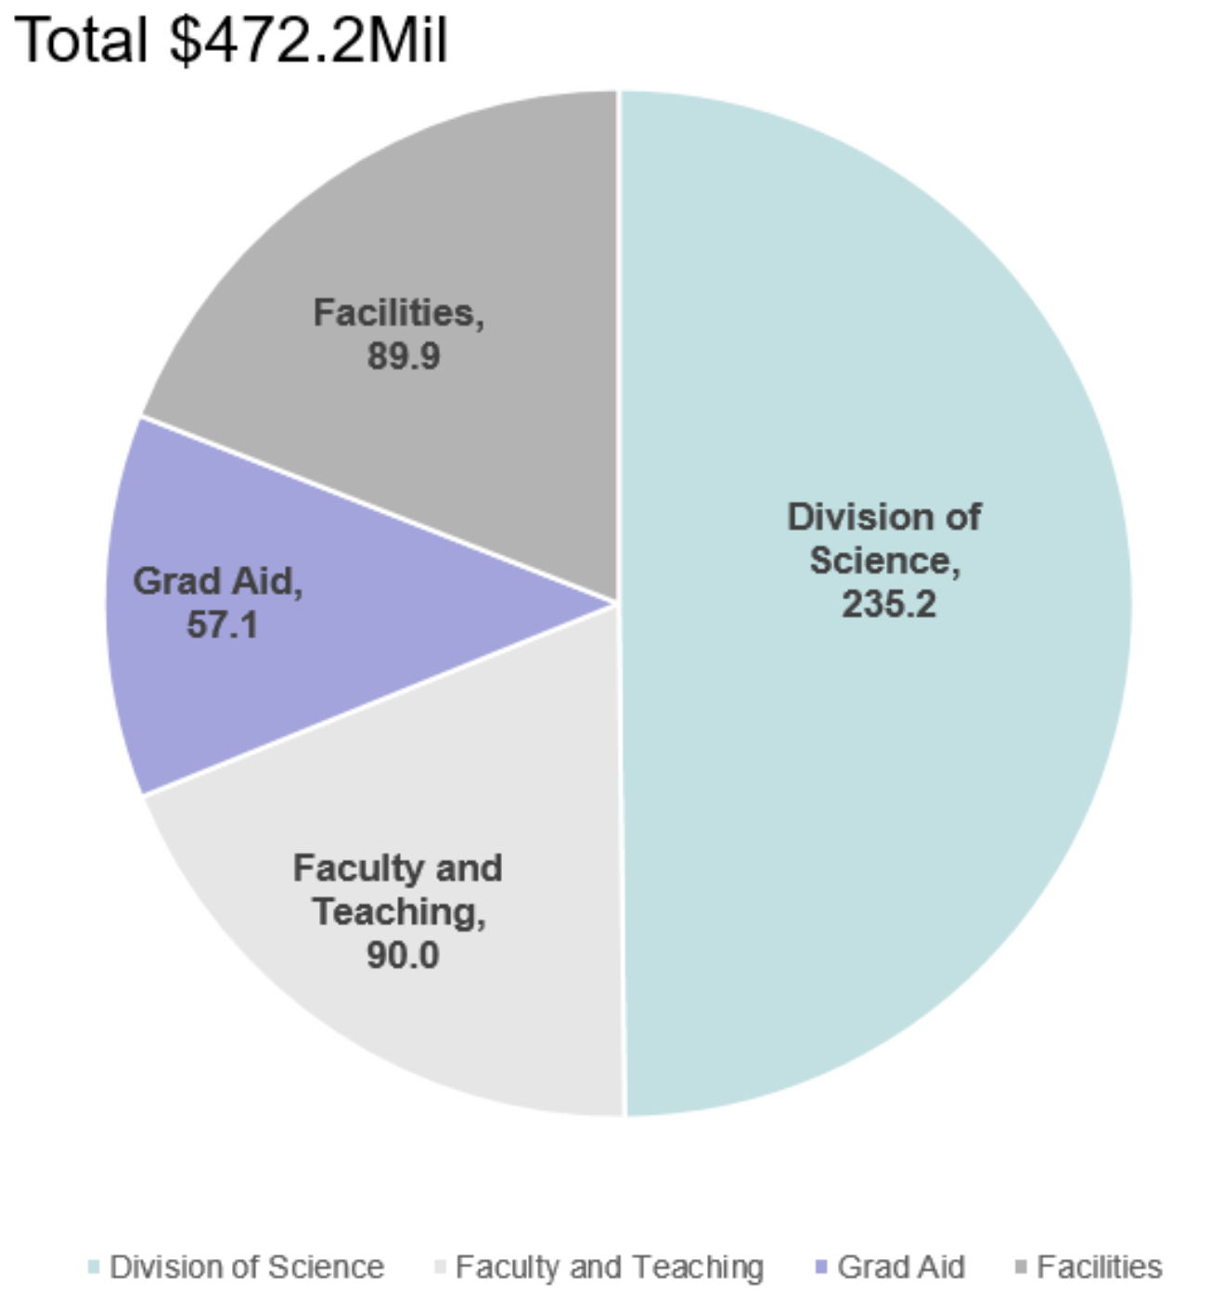
We’re a big enterprise; 470M$/year
Annual Expenses

Slide 18
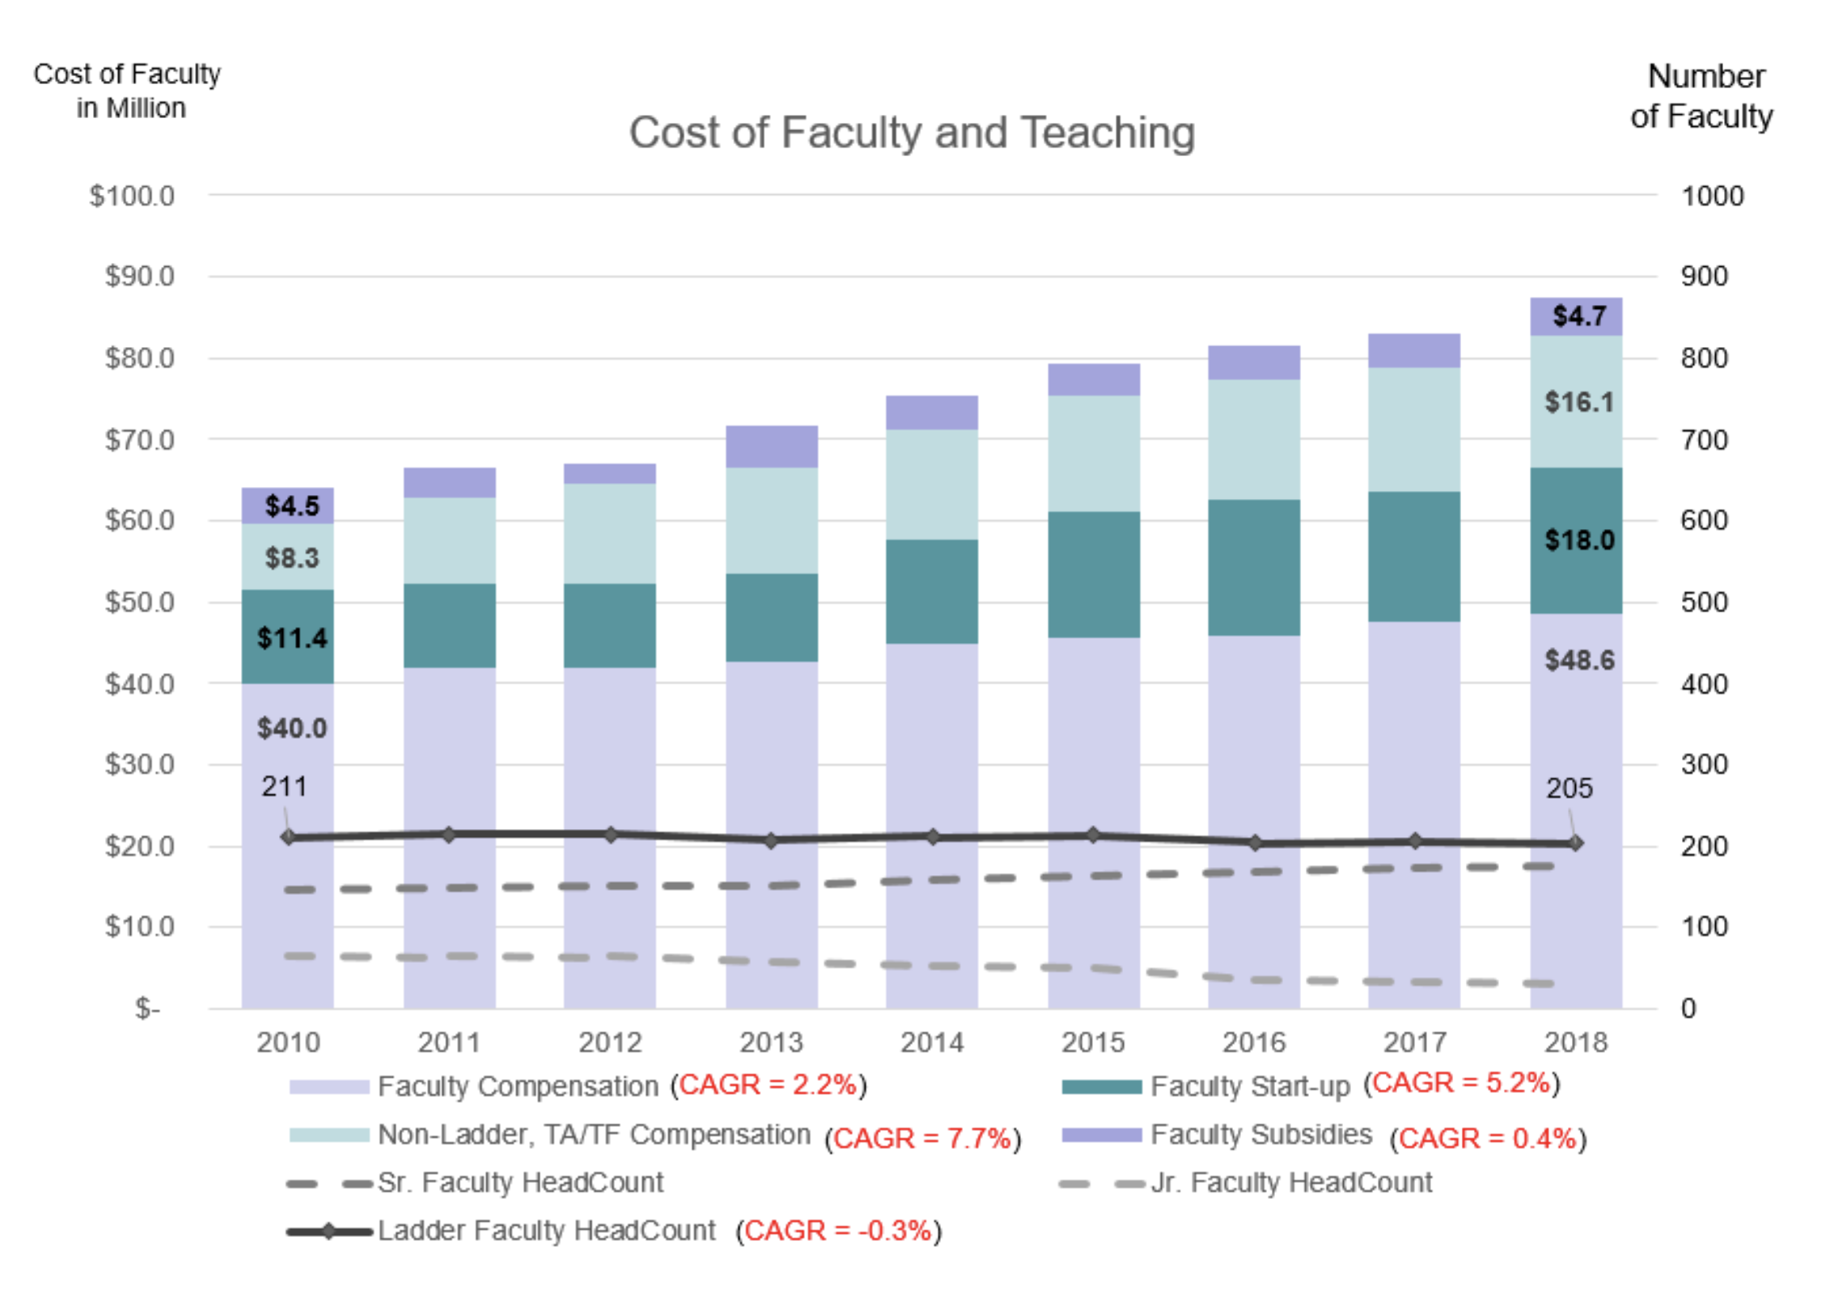
FAS Science Ladder Faculty (2010 – 2018)

Slide 19
Our Graduate Program is under financial stress, with worrisome trends
Net Unrestricted Gain/Loss on PhD Programs By Division
$$$
In Mil
Arts & Humanities
Sciences
Social Science
2015 | 2016 | 2017 | 2018
2015 | 2016 | 2017 | 2018
2015 | 2016 | 2017 | 2018
7.1% CAGR
1% CAGR

Slide 20
Sponsored Research Expenses
Modest growth in $
2.6% CAGR
(w/o ARRA)
5.9% CAGR
*As part of the American Recovery & Reinvestment Act (ARRA), the Fed earmarked $7.5Bil for scientific research. Most ARRA grants ended in FY12
Notes:
20
20
A growing share of the cost of financial aid is being supported by unrestricted dollars.
In FY10, unrestricted support for financial aid will have grown by $50 million since FY2003.

Slide 21
No new space in a decade
1,503k Net Assignable Square Feet (NASF)
  Lab Space: 734k NASF (50%)
  Office Space: 363k NASF (26%)
  Other Space: 244k NASF (21%)
  Classroom Space: 39k NASF (3%)
FAS Physical Plant Growth
(with significant additions annotated)
Gross
Square
Feet (000)
Wisconsin Ave DC (2011)
9,665 square feet
Mallinckrodt-Hoffman Link (1996)
Murr (1999)
Sherman Fairchild (1981)
Malkin (1930)
Dunster (1930)
Eliot (1931)
Biological Lab (1931)
Holmes Hall (1952)
Herbaria (1953)
Quincy (New) (1958)
Comstock Hall (1958)
Mather Hall, Quincy House (1912)
Widener Library (1915)
Gore Hall, Winthrop House (1916)
Standish Hall, Winthrop House (1916)
Smith Hall, Kirkland House (1916)
Naito (2000)
Rowland (2002)
CGIS (2005)
LISE (2007)
Northwest Science (2008)
Biological Research Infra. (2006)
Mather (1970)
Science Center (1973)
Blodgett/Bright/Gordon (1977)
Massachusetts Hall (1720)
Peabody Museum (1876)
Memorial Hall (1878)
Museum of Comp. Zoo. (1888)
University Museum (1891)
Perkins Hall (1895)
Leverett (1960)
William James Hall (1964)
Houghton Library (1942)
Vanserg (1946)
Lamont Library (1948)
Clavery Hall (1920)
Mallinckrodt Chemistry Lab (1929)
Barker Center (Union/Burr) (1901)
Stadium (1903)
Emerson Hall (1906)
Note: Excludes SEAS Bldgs and Harvard Inn (2013), as well as the Arboretum’s Weld hill (2010) although its greenhouse is utilized by FAS faculty
Science Buildings noted in Red
Notes:
21

Slide 22
FAS Division of Science and SEAS Campus Map

Slide 23
We spend $34 Million a year on Science Scholarly Infrastructure

Slide 24
My goals are to strengthen and, as appropriate, expand this infrastructure
Execute thoughtful, deliberate evolution of apparatus, capacity, and capabilities.
Capitalize on our outstanding technical staff to support both research and learning.
Coordinate across departmental, divisional, and other-school resources.
Increase faculty engagement in strategic planning and procurements.
Identify what we really care about- we bill for genetic sequence data, while we provide hands-on instruction and consultation to students and postdocs.
Establish a culture of agile instrumentation, with the technical expertise and capabilities to empower learners and scholars at all career stages to create, refine, and exploit novel measurement and analysis techniques.

Slide 25

New Initiatives at Harvard Medical School
David Golan MD, PhD
Dean for Research Operations and
Global Programs
Caroline Shamu, PhD
Scientific Director for Research Cores and Technology
May 2, 2019

Slide 26
New Initiatives at Harvard Medical School
Data Science
Epigenetics/Epigenomics
Healthy Aging
Innovation Awards
Therapeutics Initiative (I-Hub, Foundry, Translator, LSP/Reg Sci, Lifelab)
Vaccine Initiative

Slide 27
Therapeutics Initiative
Steering Committee
I-Hub
Foundry
Translator
LSP/RegSci

Slide 28
Therapeutics Initiative
Steering Committee
I-Hub
Foundry
Translator
LSP/RegSci
Director: Tim Mitchison
-Ideation and team building
-Bridges to local industry
-Education
-Faculty development
-Project support via QFASTR
Director: Caroline Shamu
-Cutting-edge shared research facilities
-New technology development
-Support basic and translational research
-In-house and out-sourced models
Director: TBA
-Translation of early stage research
-Partnerships with VCs and other funders
-Includes neglected diseases
Director: Peter Sorger
Laboratory of Systems
Pharmacology/Regulatory Science
-Drug and disease mechanism
-Drug repurposing
-Drug evaluation
-Patient selection
-Clinical trial design
-Mechanistic toxicology

Slide 29
Therapeutics Initiative at HMS
Education
Training, faculty development
Trainees
Industry profess’als
Ideation hub
Faculty
MDs
Therapeutics initiative
Open platforms
Benefit all HMS research
Faculty labs
Foundry
LSP/RegSci
Highly selective
VC support
Foundation support
Philanthropy for specific diseases, vaccines, etc?
Translator
Discovery
publication
INDs NewCos Vaccines Diagnostics

Slide 30
Harvard Medical School Foundry
https://corefacilities.
hms.harvard.edu

Slide 31
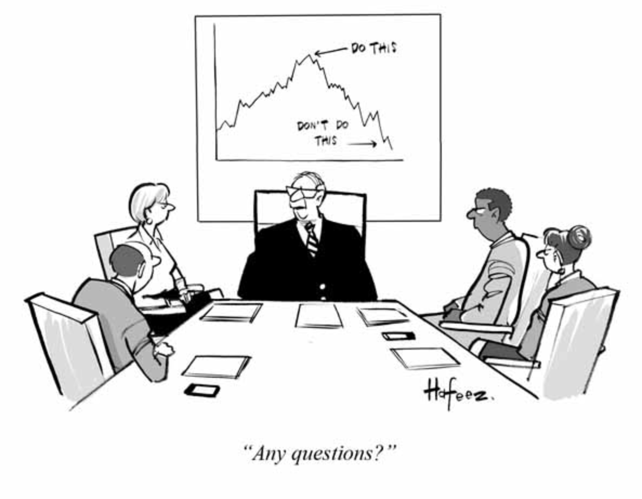
Hafeez, Barrons

Slide 32

BREAK
10:45 – 11:00

Slide 33
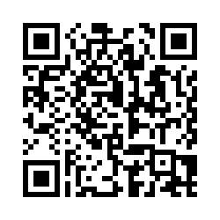
Today’s first exercise...
SWOT Analysis - What do you see as our division’s primary Strengths, Weaknesses, Opportunities, and Threats?
https://science.fas.harvard.edu/fasscience2030-surveys
11:00 – 11:15 - Complete individual response
11:15 – 11:30 - Discuss with your table

Slide 34
BEFORE WE HAVE LUNCH…

Slide 35
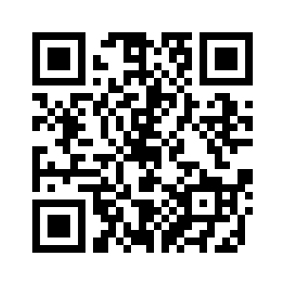
What is #consciousharvard?
#consciousharvard is an initiative that creates public spaces, both physical and virtual, for action-focused dialogue about diversity, inclusion, equity and belonging at Harvard.
The project invites members of the Harvard community to offer reflections and insights in response to prompts such as “I feel excluded when…” and “Harvard can make me feel more included by…”.
Our FASscience2030 exercise uses the anonymous on-line tool, using your phone to send text messages.
Our messages today will contribute to the overall Harvard initiative. We also plan to share out the specific FASscience2030 responses that we gather today.
Our prompt for today is “I feel excluded when…” https://projects.iq.harvard.edu/consciousharvard

Slide 36
FAS Science Division 2030
Diversity, Inclusion, and Belonging
May 2, 2019
Symmetry magazine, 2018

Slide 37
Some facts to ground our conversation
50% of women faculty and staff in academia experience sexual harassment.
(NAS study 2018)
Student surveys show that 20-50% of students in science, engineering, and medicine experience sexual harassment from faculty or staff.
(NAS study 2018)
10% of our division’s ladder faculty are being or have been recently counseled regarding professional conduct issues.
A survey conducted of the faculty in one of our division’s departments showed internal climate/collegiality as worse than 18 out of 20 science & engineering departments at a peer institution.

Slide 38
Demographics in our Science Division reflect national pipeline issues
Undergraduate concentrators: 1735 (49% Women)
Graduate students: 985 (35% Women)
Postdoctoral scholars: 755 (28% Women)
Ladder Faculty: 205 (23% Women)
Diminishing
pipeline
of talent

Slide 39
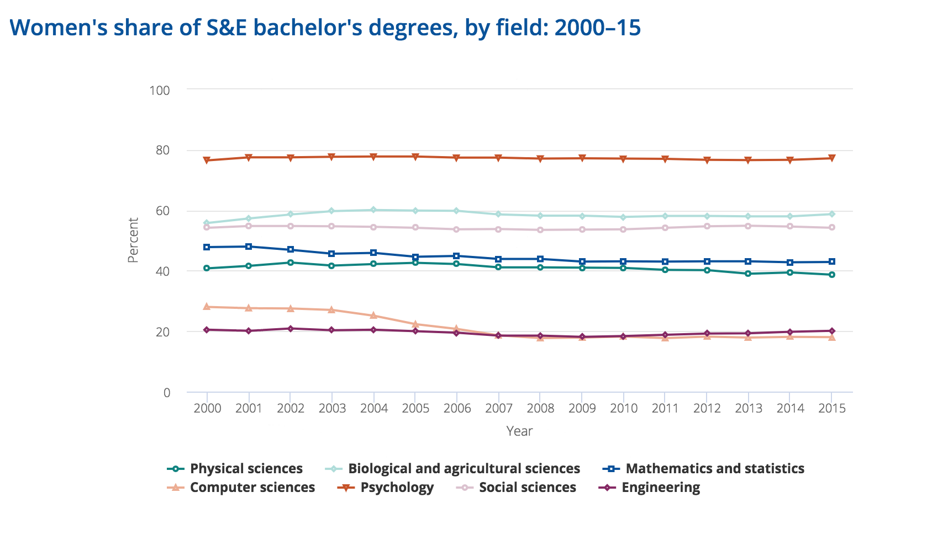
Gender diversity in STEM is a national issue
Harvard
EPS
OEB
astro
math and
statistics
physics

Slide 40
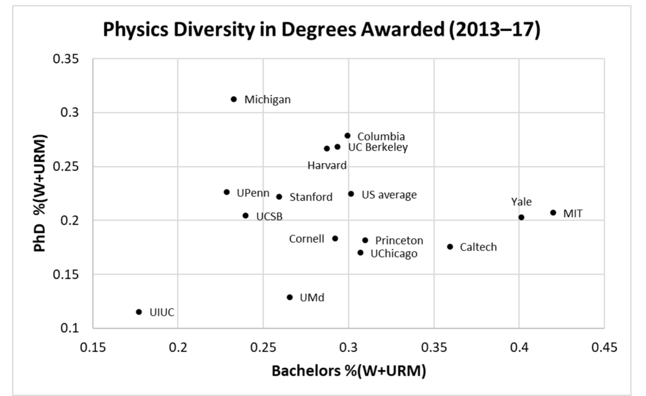
But, there are substantial differences between institutions

Slide 41
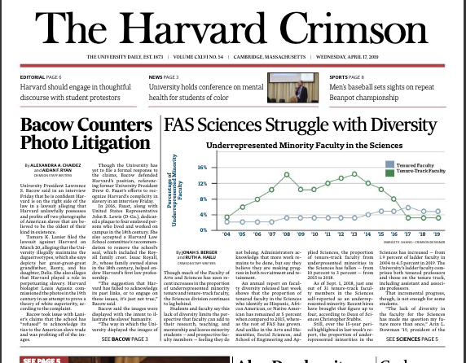

Slide 42
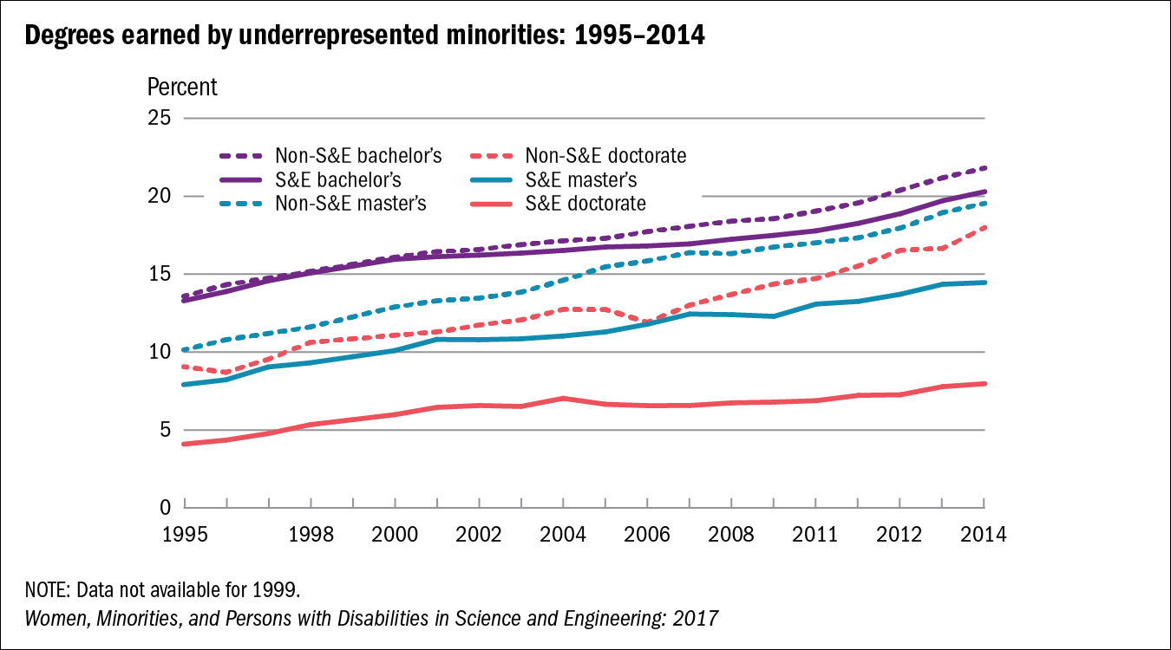
Fraction of PhD’s awarded to under-represented minorities is <10%

Slide 43
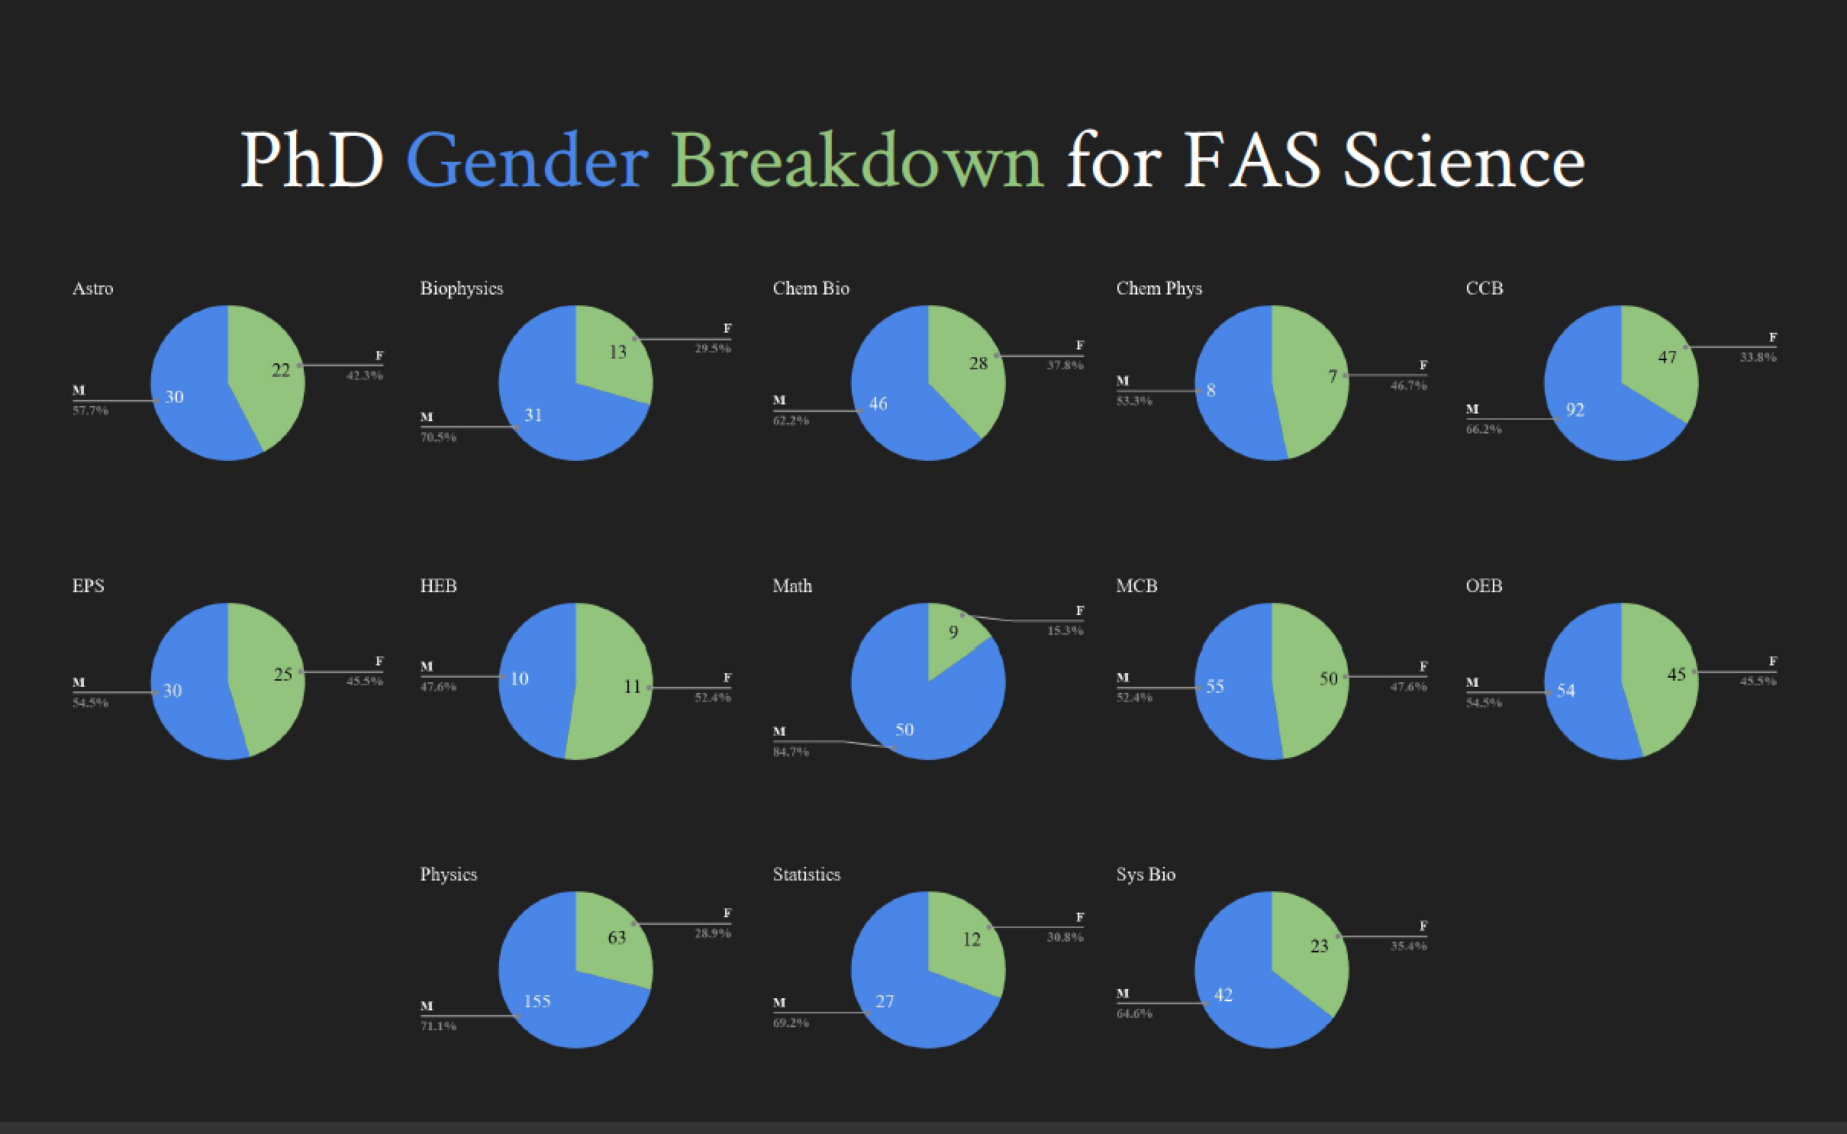

Slide 44
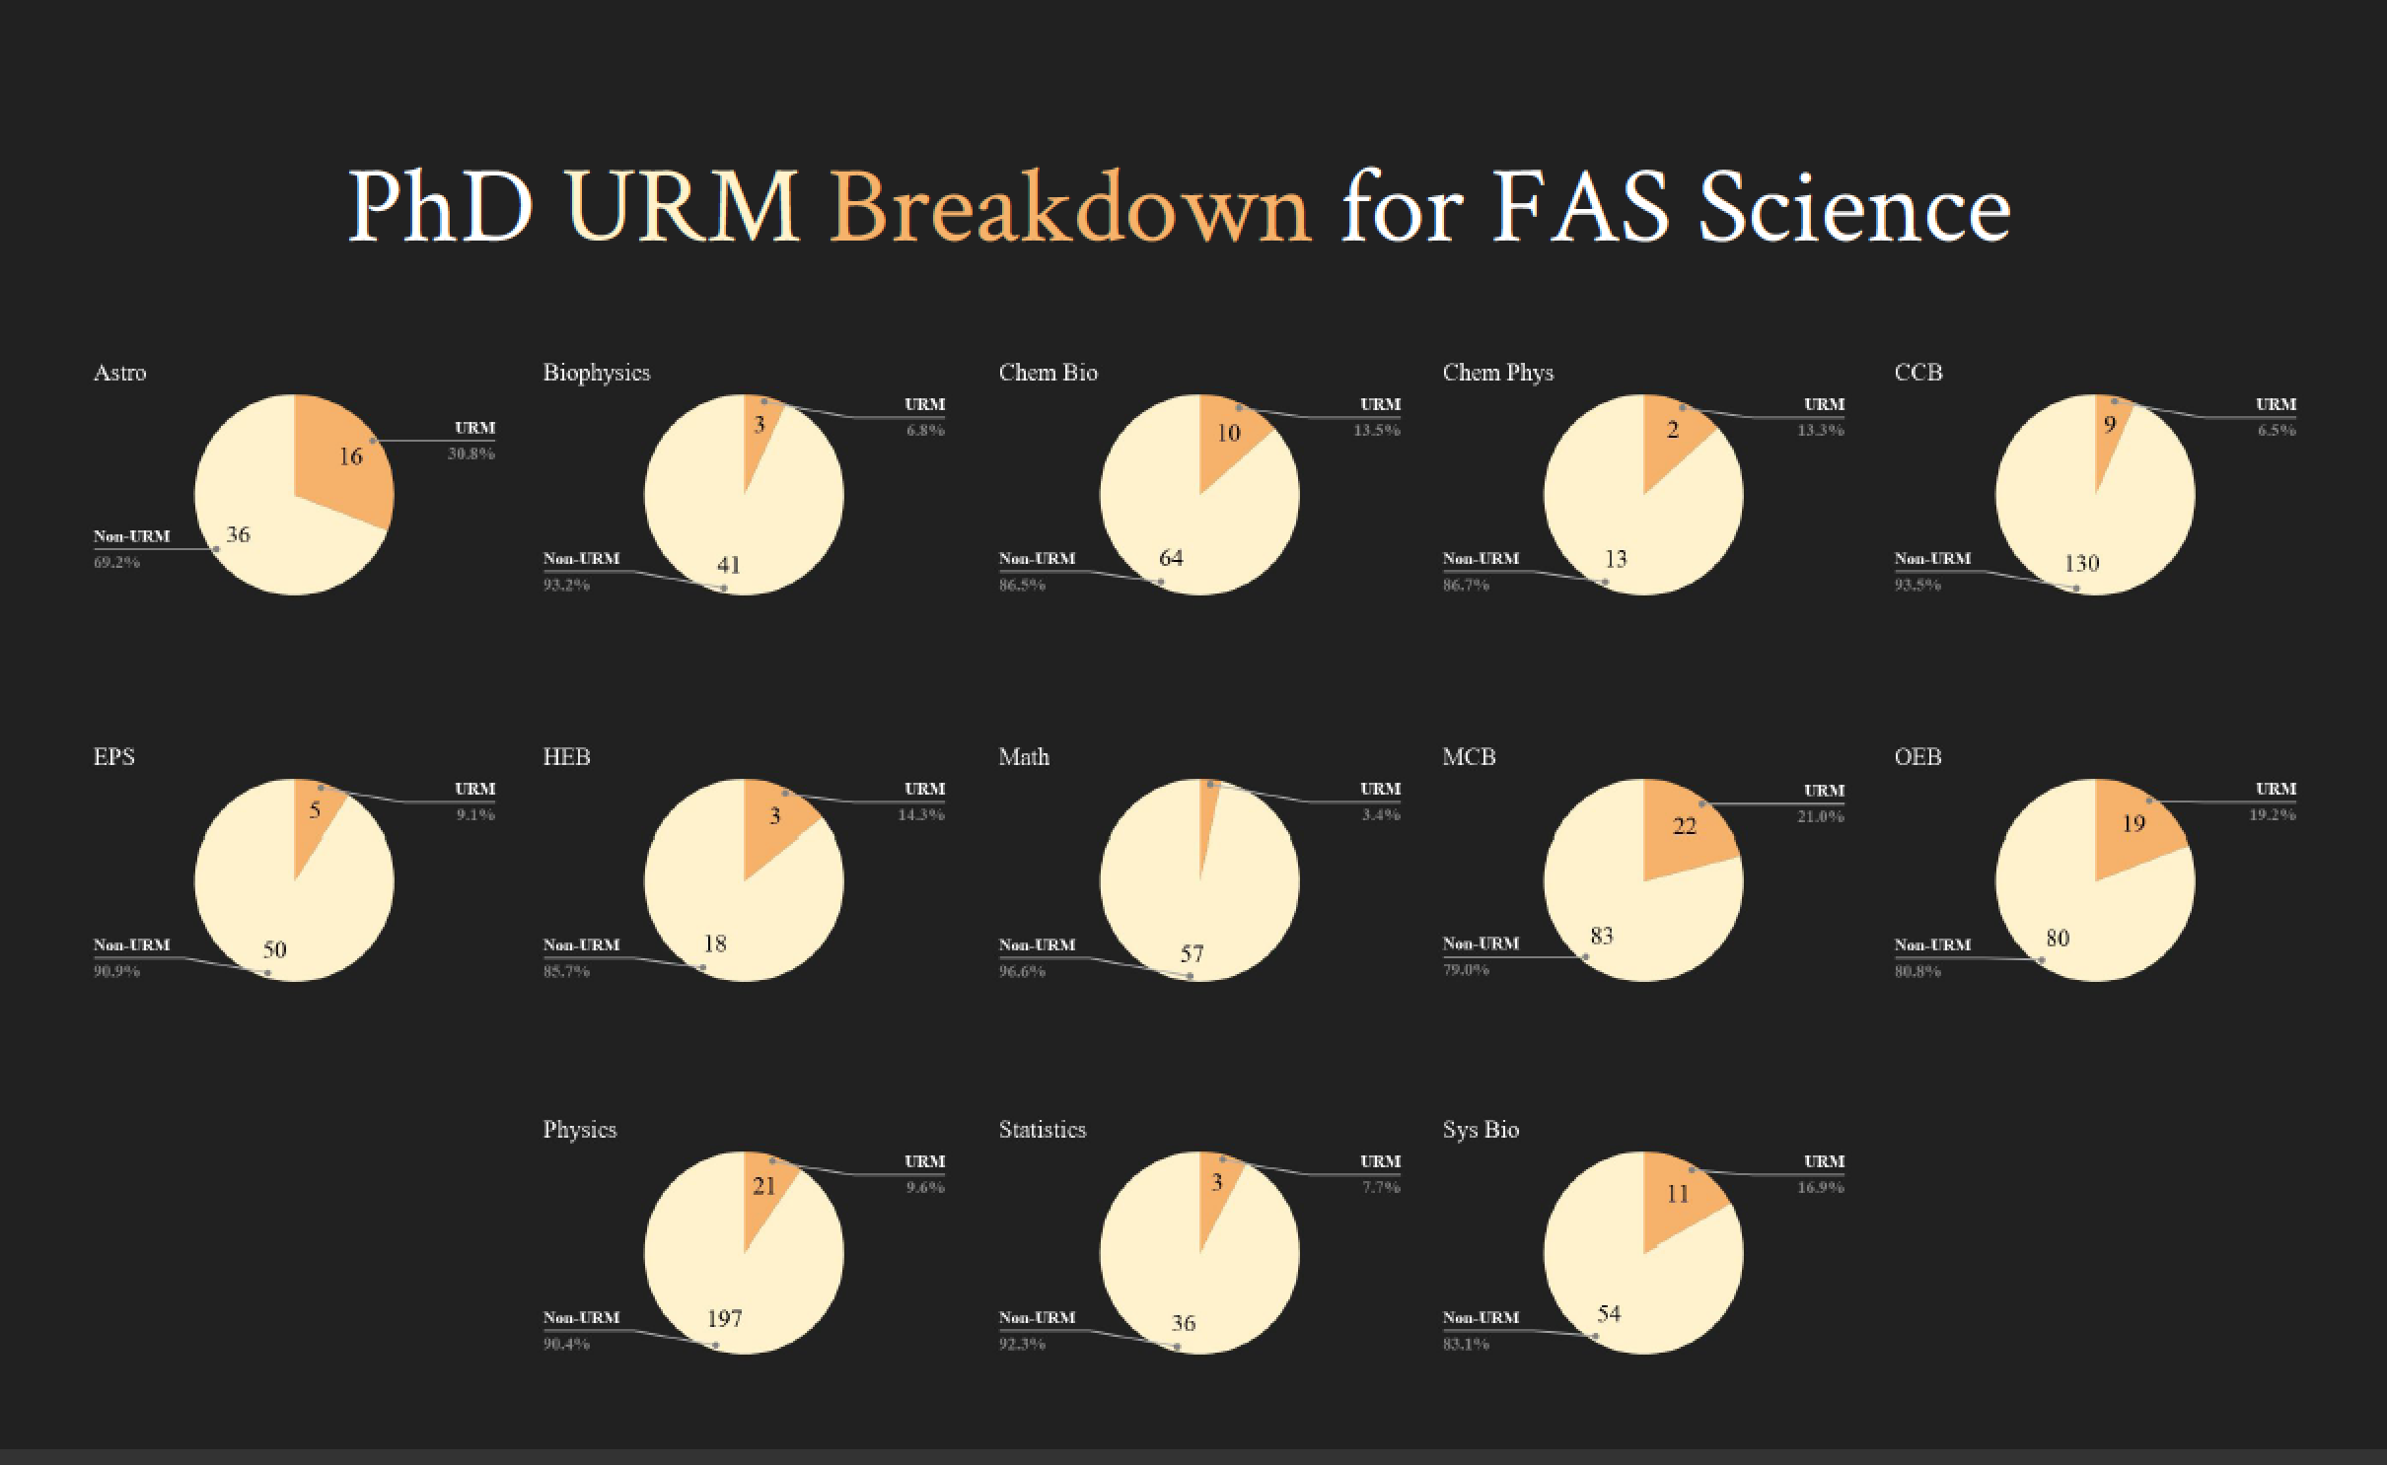

Slide 45
My Perspective
All who come to Harvard should join a supportive and respectful community.
Gender and racial diversity, departmental and unit social dynamics, inclusion, and belonging are all inter-related.
We need to shift from a compliance-based to a respect-based culture.
I expect for every individual in this room to work towards this goal!

Slide 46
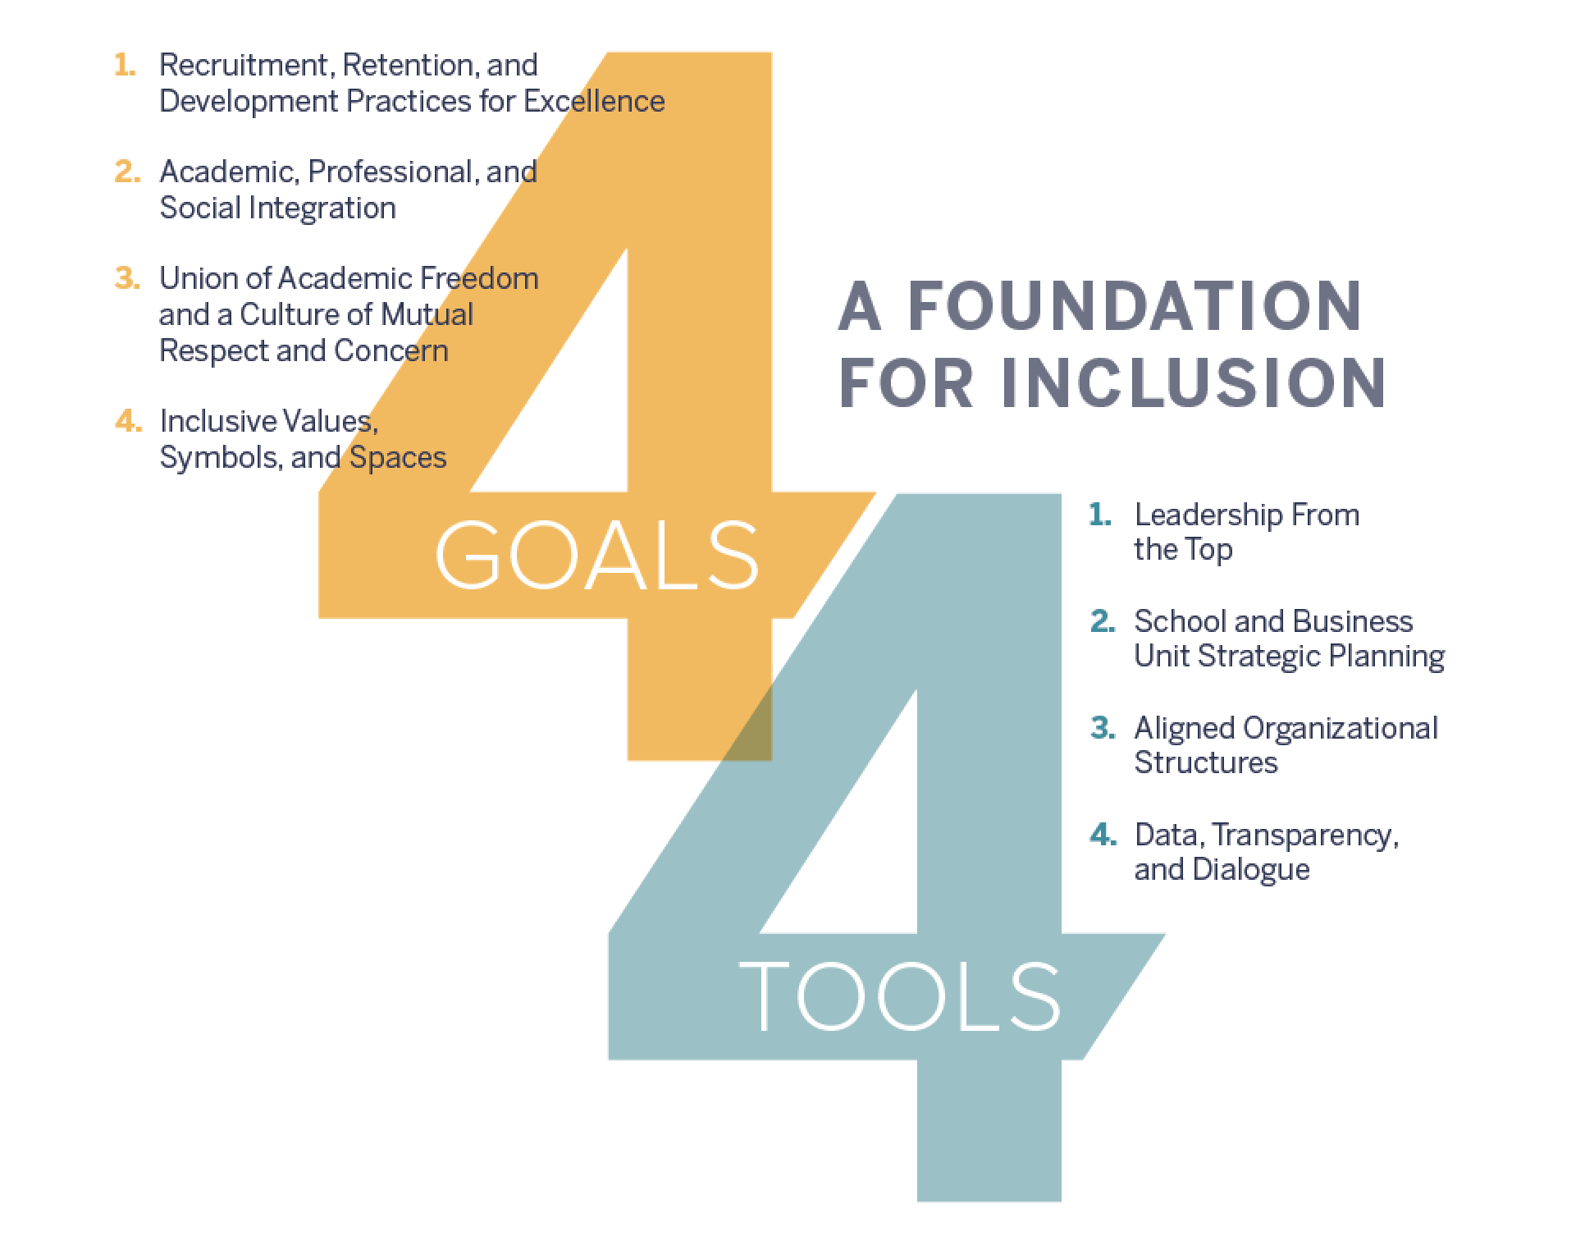
Harvard University Task Force Report

Slide 47
An exercise for your table
1.) Discuss steps you or your organization are taking to address the DIB goals.
2.) What resources or practices do you believe the Science Division Dean’s office and/or the FAS could offer to make substantial long-term progress to strengthen Diversity, Inclusion and Belonging for FASscience2030?
Time: 30 Minutes
We have already designated people to capture the discussion at each table. Pick another person from your group to summarize your answers to these questions at the end of the exercise.

Slide 48
BREAK
1:45 – 2:00

Slide 49
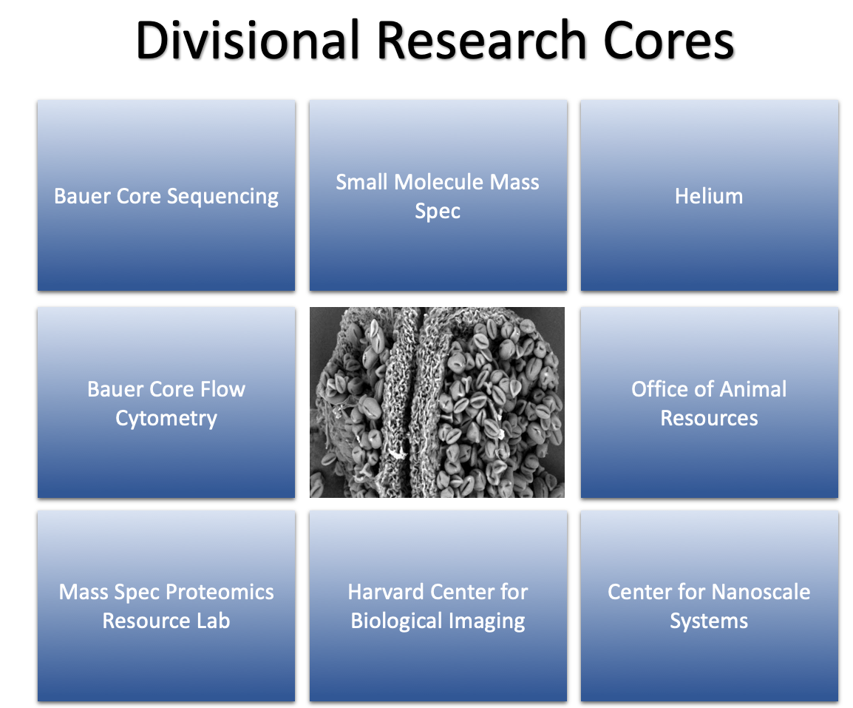

Slide 50
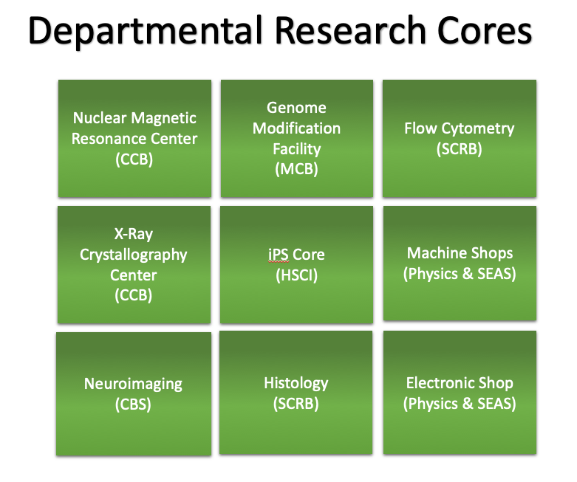

Slide 51
We spend $34 Million a year on Science Scholarly Infrastructure

Slide 52
Research Core Facilities
(FY18 Actuals, $$ in Million)
Break-even line for Service Centers
Expenses
Income
Total User Billing Revenue
Notes:
52

Slide 53
Space, Staff, Stuff, Structure Exercise
SPACE – Shared spaces for research, teaching & community (excludes PI labs)
STAFF – Programmatic, technical & scientific staff working across the Division
STUFF – Equipment, infrastructure, supplies & services
STRUCTURE & GOVERNANCE – Consultative decision making & prioritization
Time: 30 minutes
We have already designated people to capture the discussion at each table. Pick another person from your group to report out verbally at the end of the exercise.

Slide 54

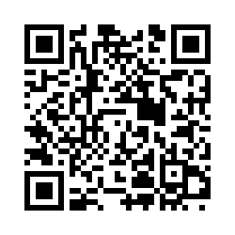
Thank You!!
Please complete our online survey
Feedback Form

