Slide 1

Generative artificial intelligence, scholarship and teaching
A SEAS/Science Division Faculty Chat
April 2023

Slide 2
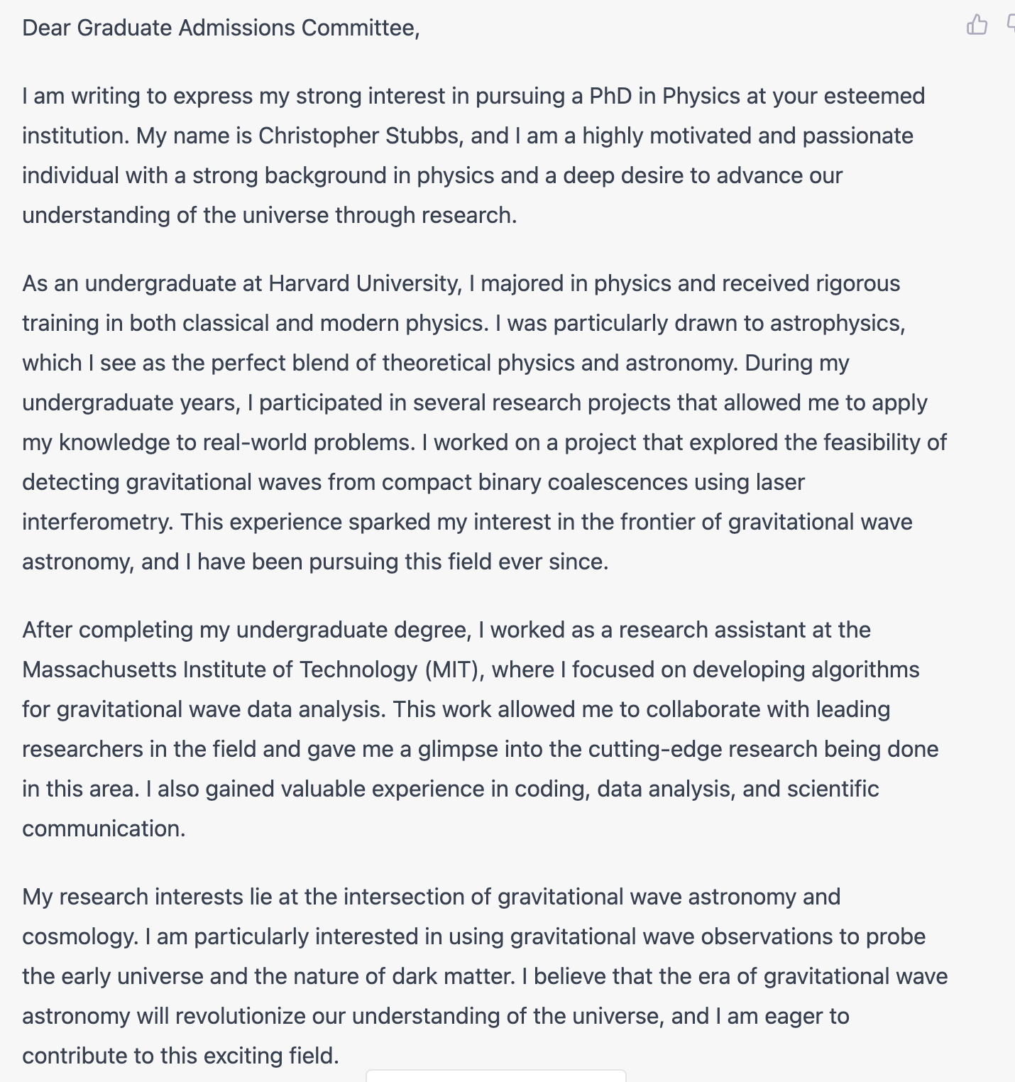
Why all the excitement?
Chat-GPT* prompt:
“Write a graduate school application essay for Christopher Stubbs for a PhD in physics” produces this:
*GPT=Generative Pre-Trained Transformer
https://chat.openai.com/chat

Slide 3
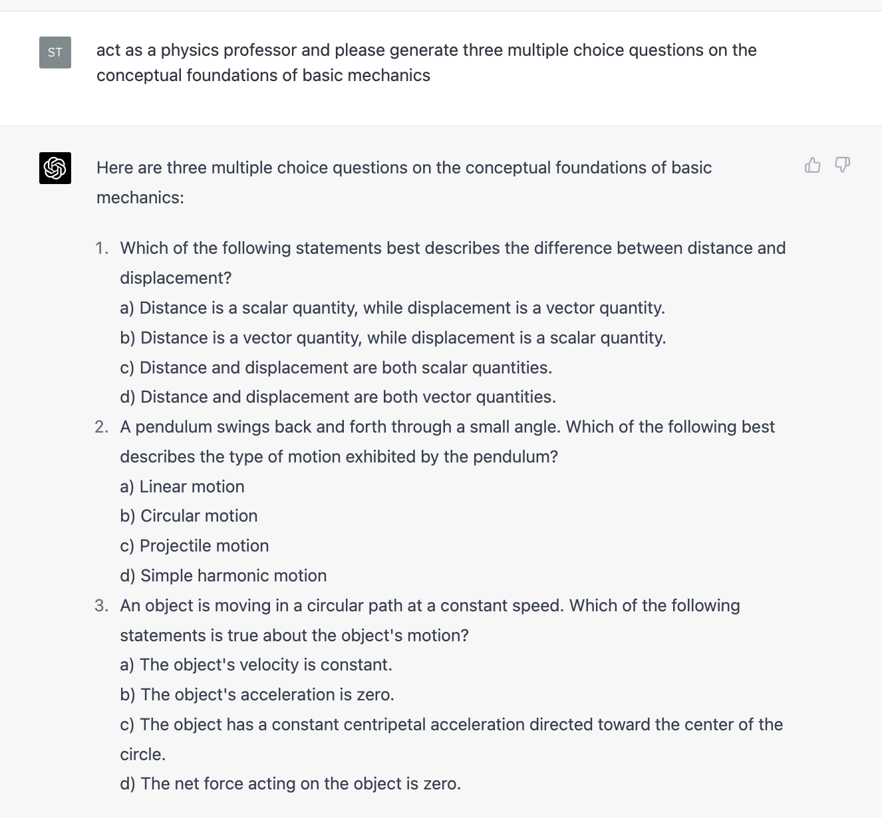
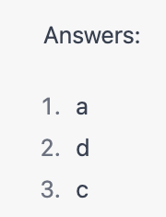
Or how about…

Slide 4
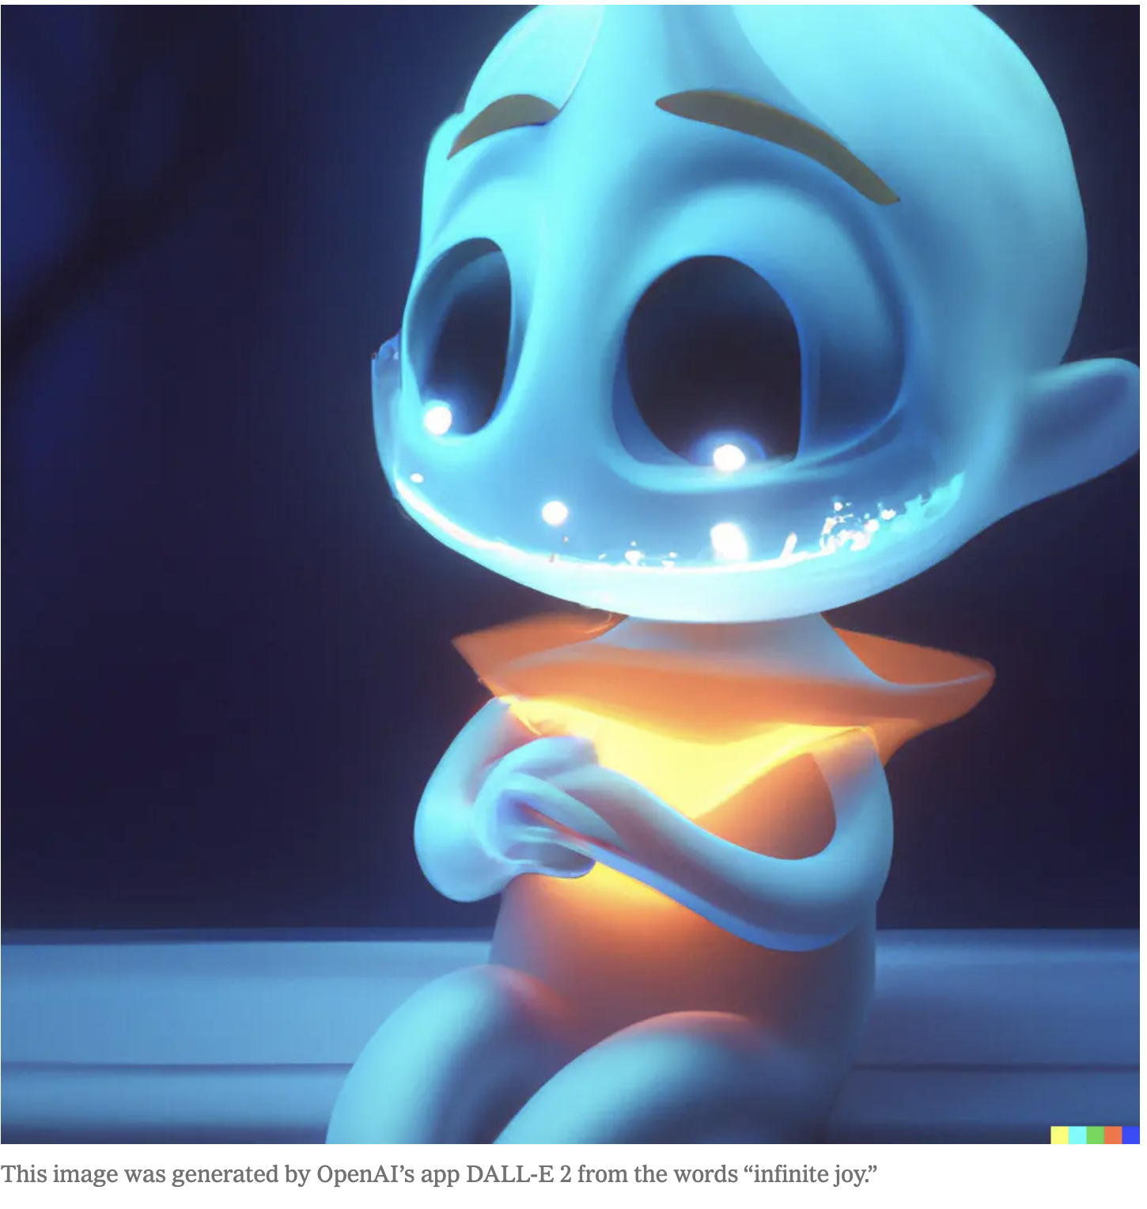
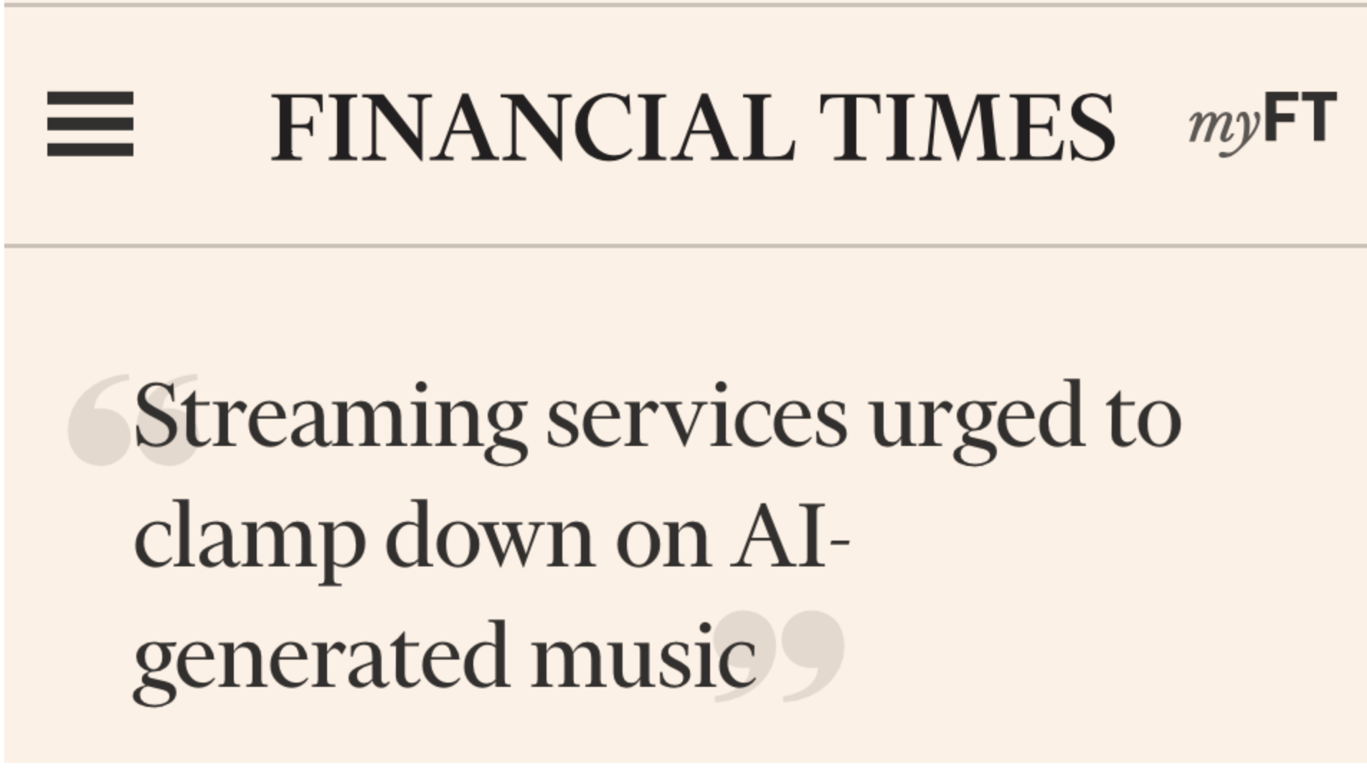
Audio-visuals too
NYT Aug 2023

Slide 5
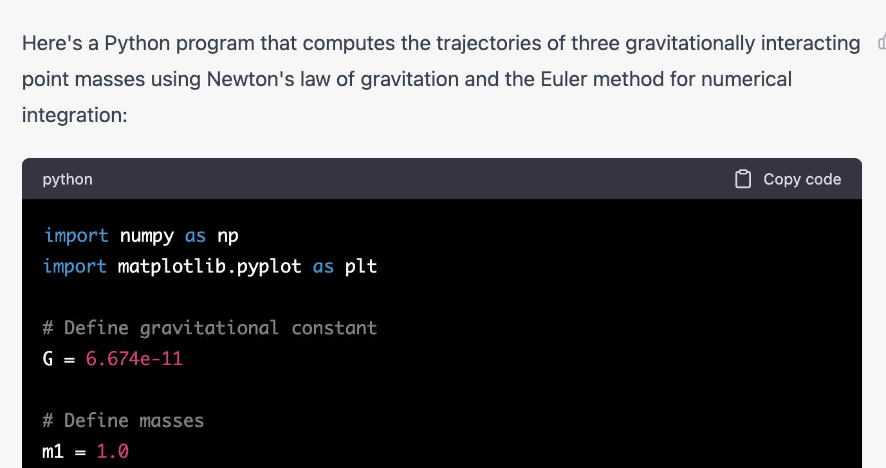
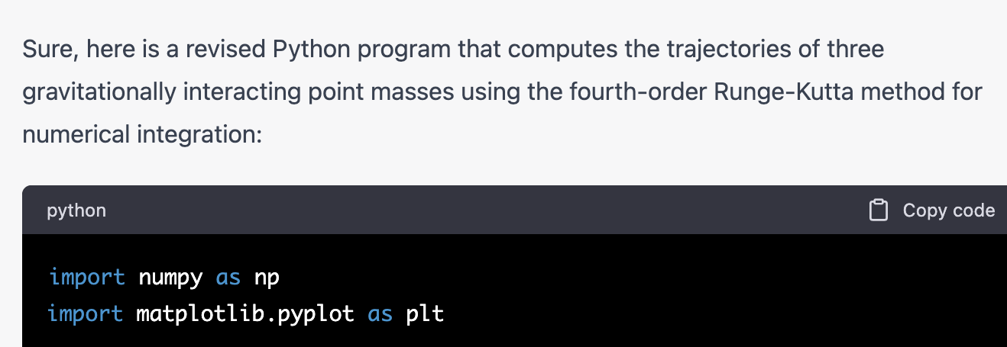
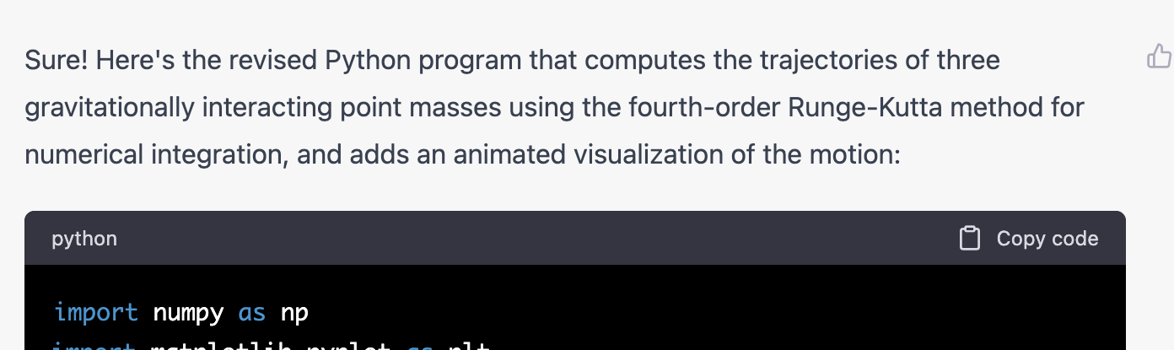
Example: Iterative generation of code, from successive natural language prompts.
1) Generate a numerical simulation of 3-body gravitating system
2) Change from Euler to
Runge-Kutta integrator
3) Add animation

Slide 6
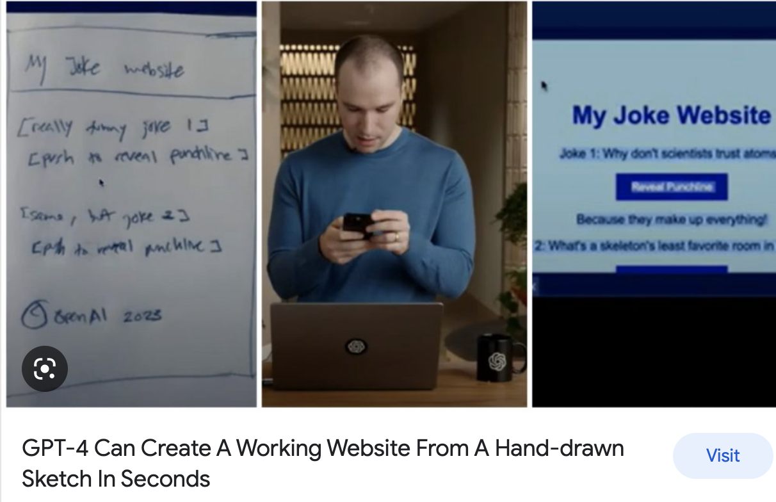
Example:
Auto-generation of HTML code for a website from a napkin sketch
https://www.youtube.com/watch?v=outcGtbnMuQ
at 16:10

Slide 7
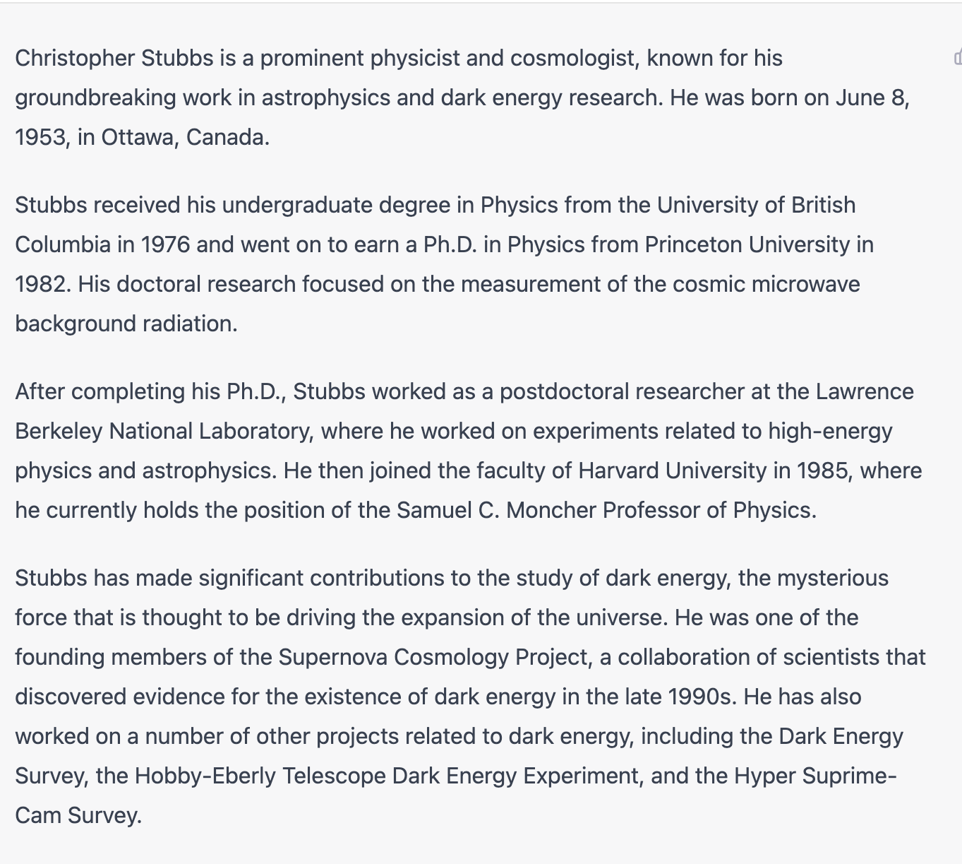
Aggregation & synthesis of Information
Chat-GPT prompt:
“produce a biography for Christopher Stubbs”

Slide 8
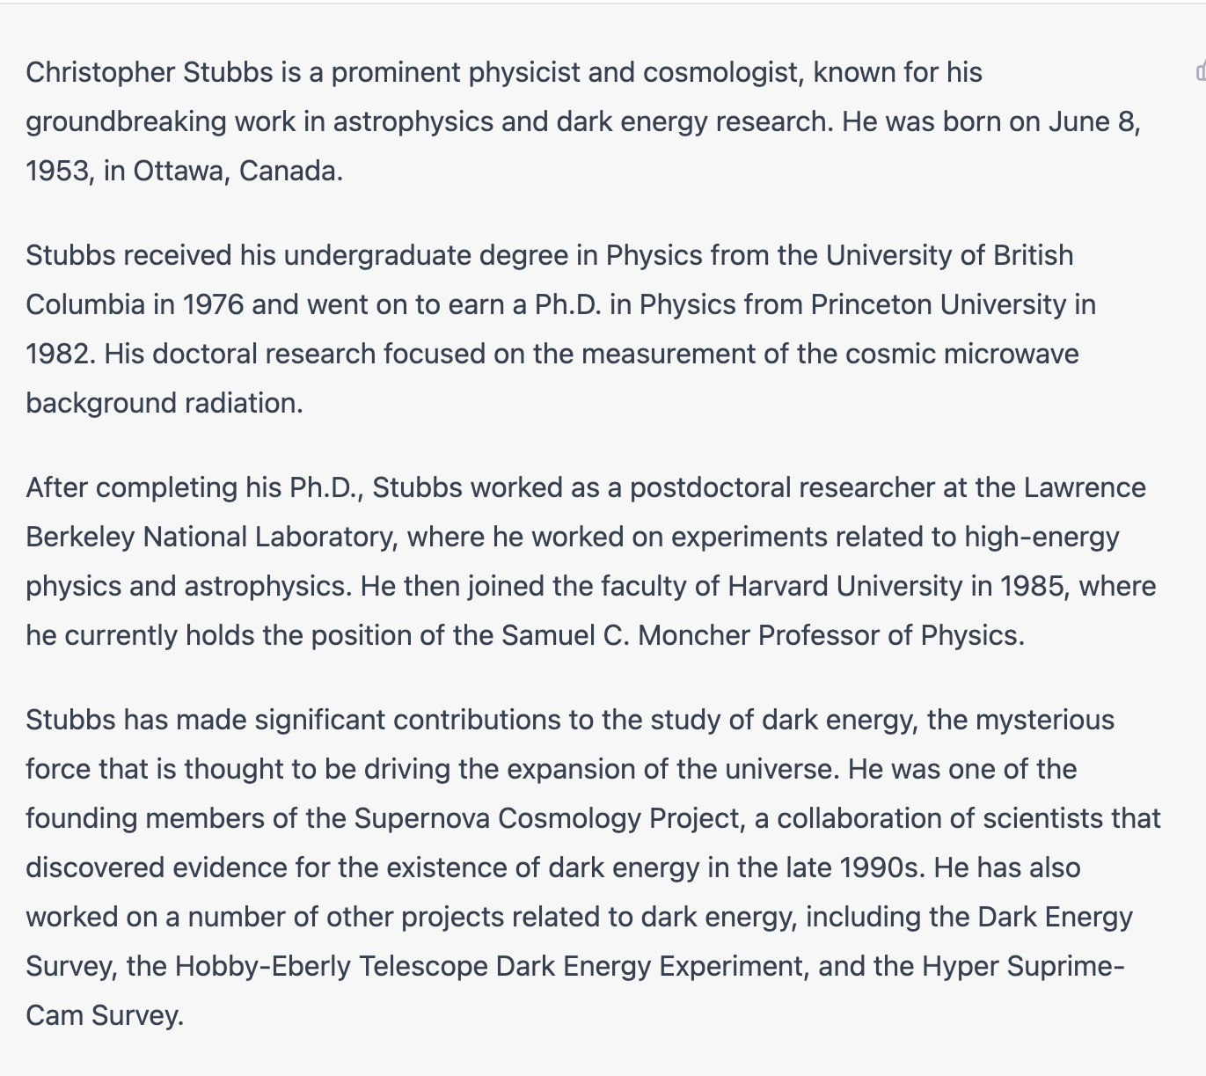
No!
Much of this is disinformation*!
Chat-GPT ‘hallucination’
How would you know?
*this was GPT3.5, version 4 does better

Slide 9
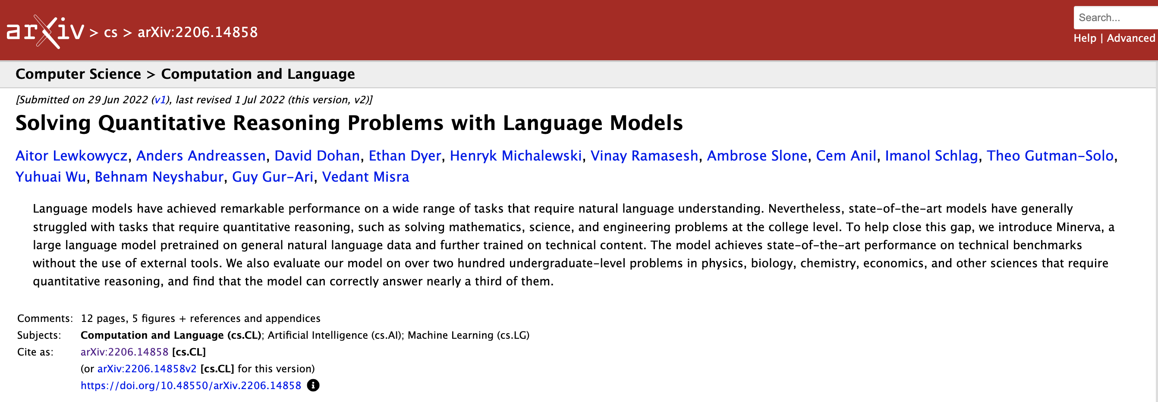
Current capabilities go far beyond “just” producing text and code and music and images…

Slide 10
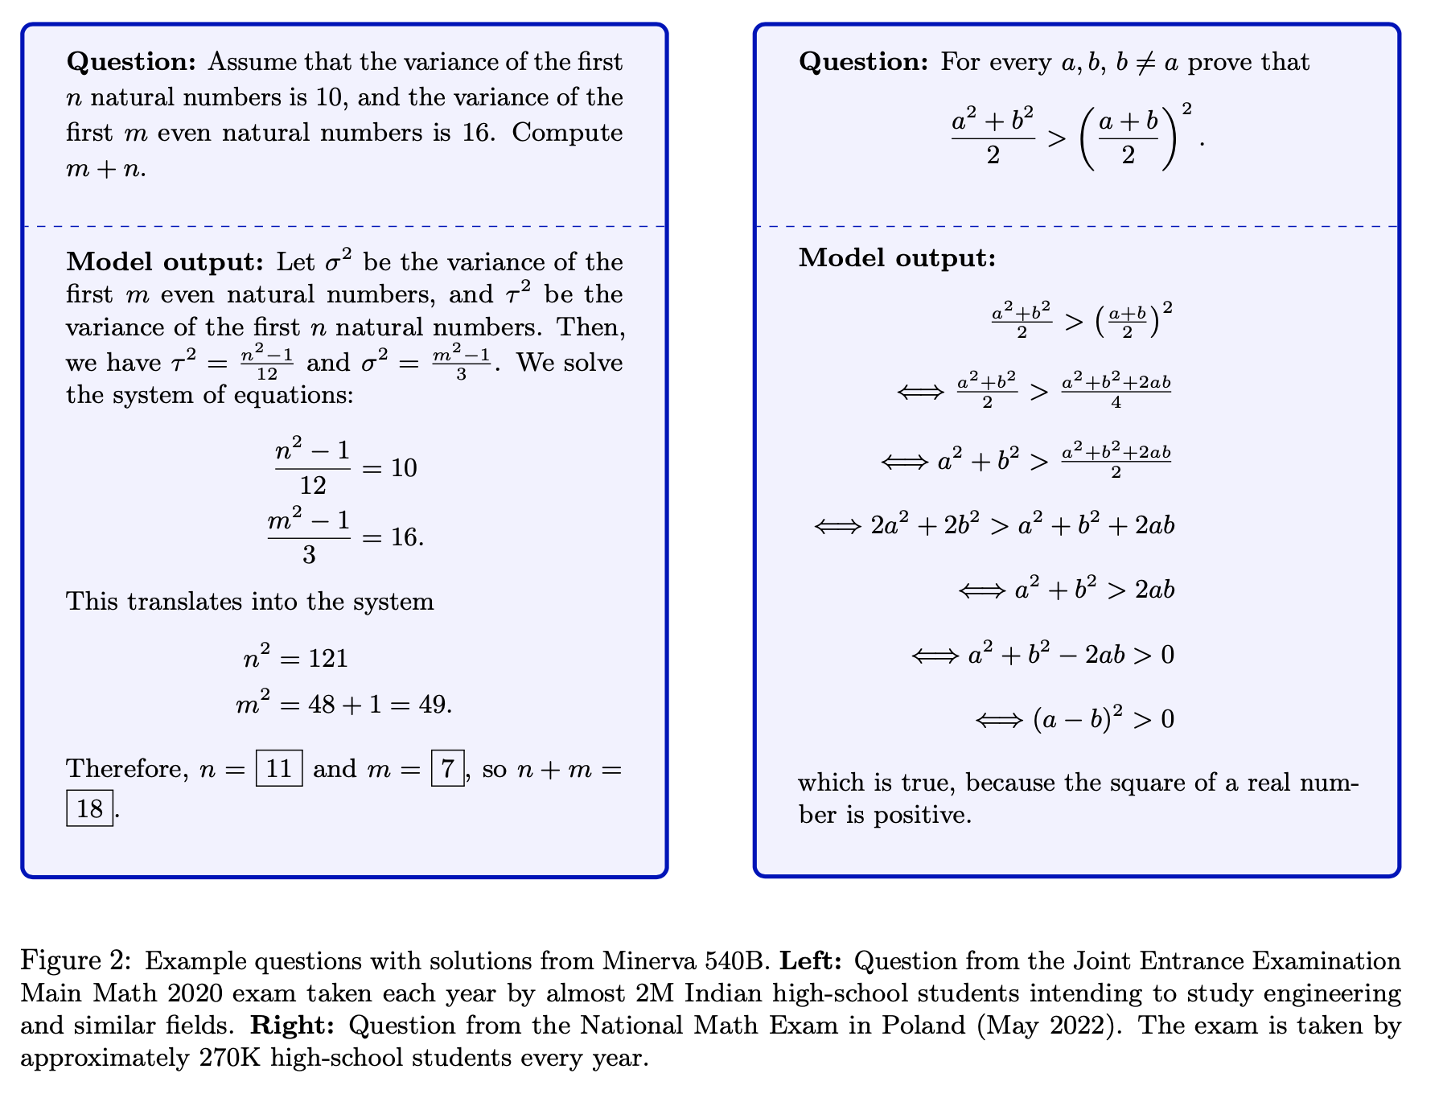

Undergraduate-level STEM coursework?
Yes

Slide 11
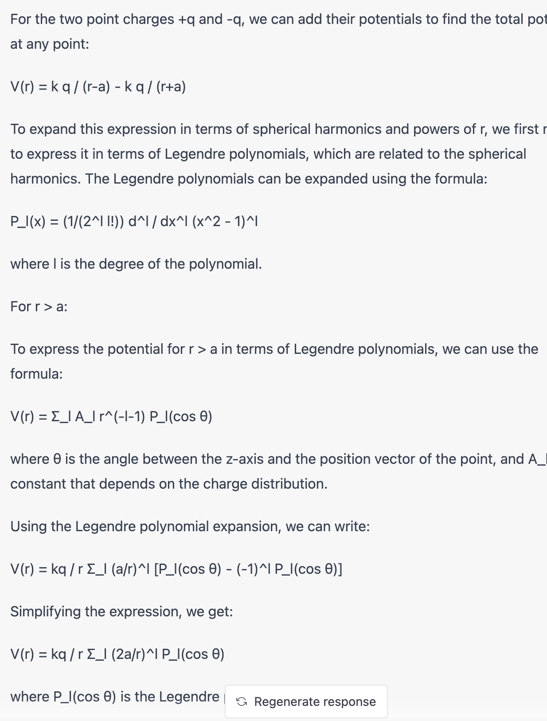
What about graduate-level physics
coursework? Yes.
Problem 3.6 from Jackson’s graduate text on Electrodynamics:
“Two point charges +q and -q are located on the z axis at z=+a and z=-a, respectively. Find an expression for the electrostatic potential as an expansion in spherical harmonics and powers of r for both r>a and r<a”
Chat-GPT4 produced a good answer:

Slide 12
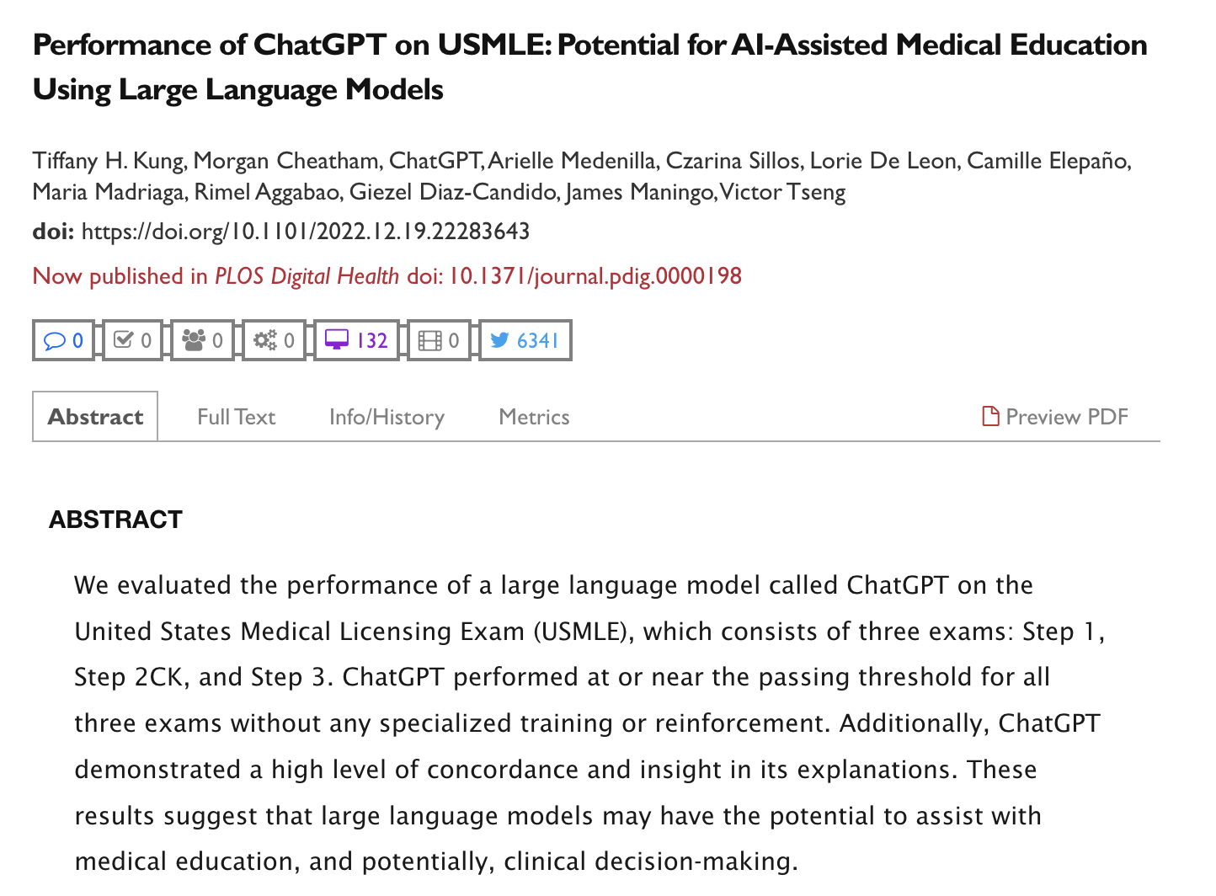
Medical licensing exam?
Yes

Slide 13
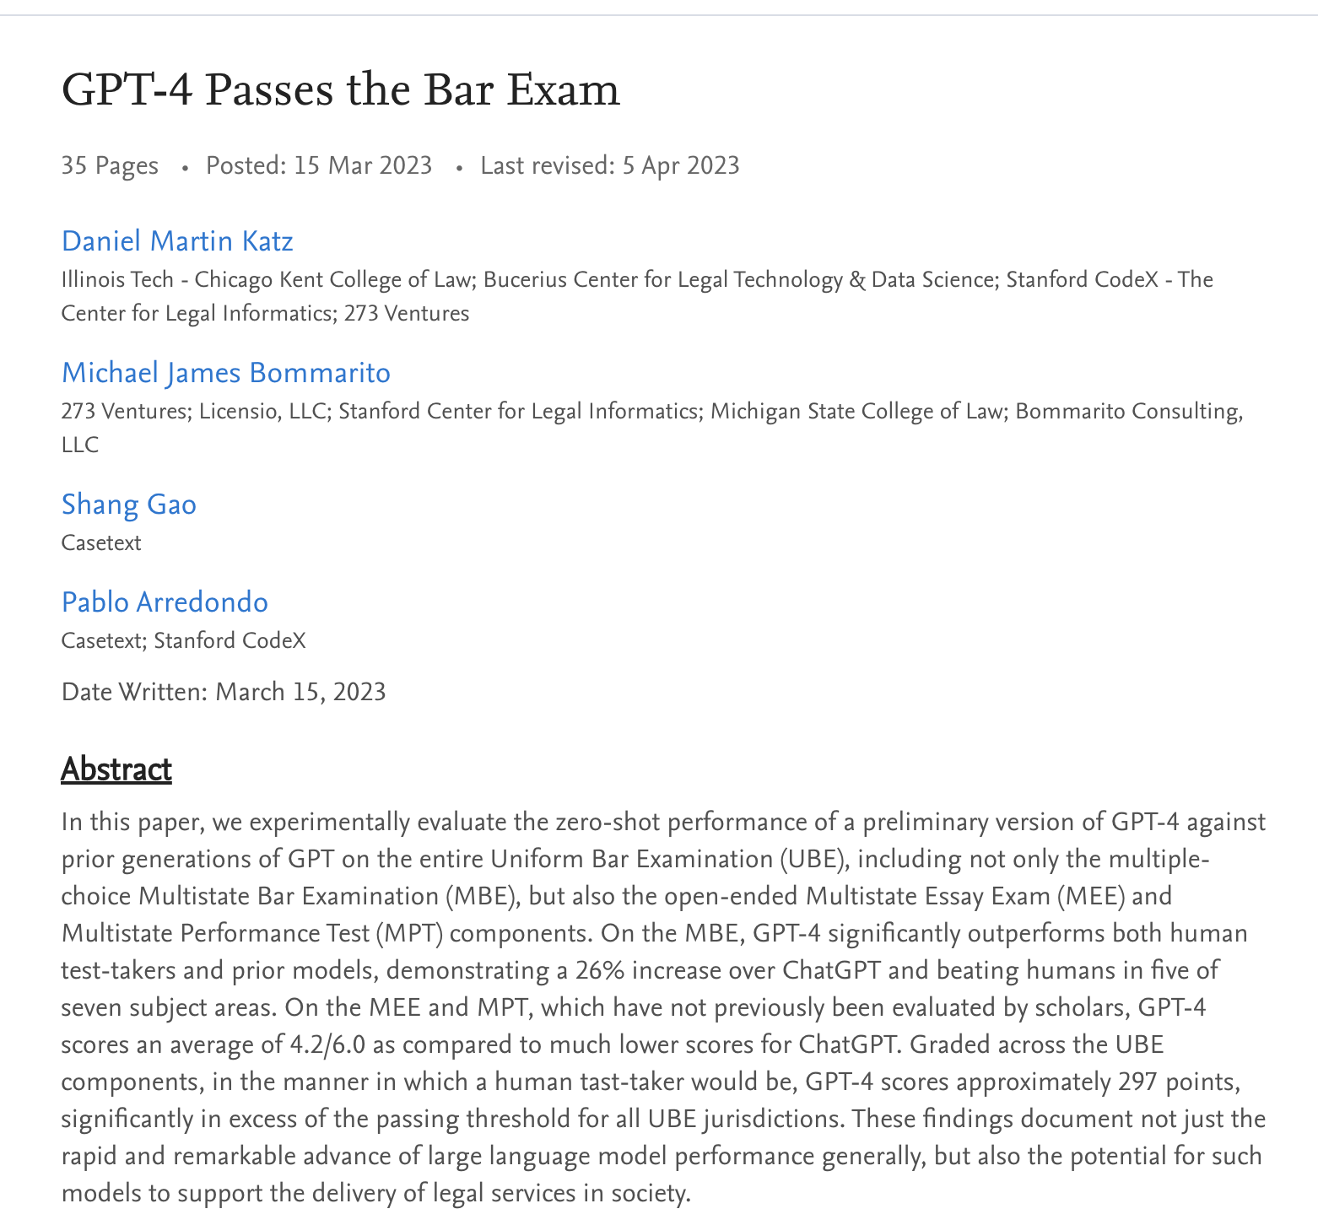
Bar exam for lawyers?
Yes, including the essay component.

Slide 14
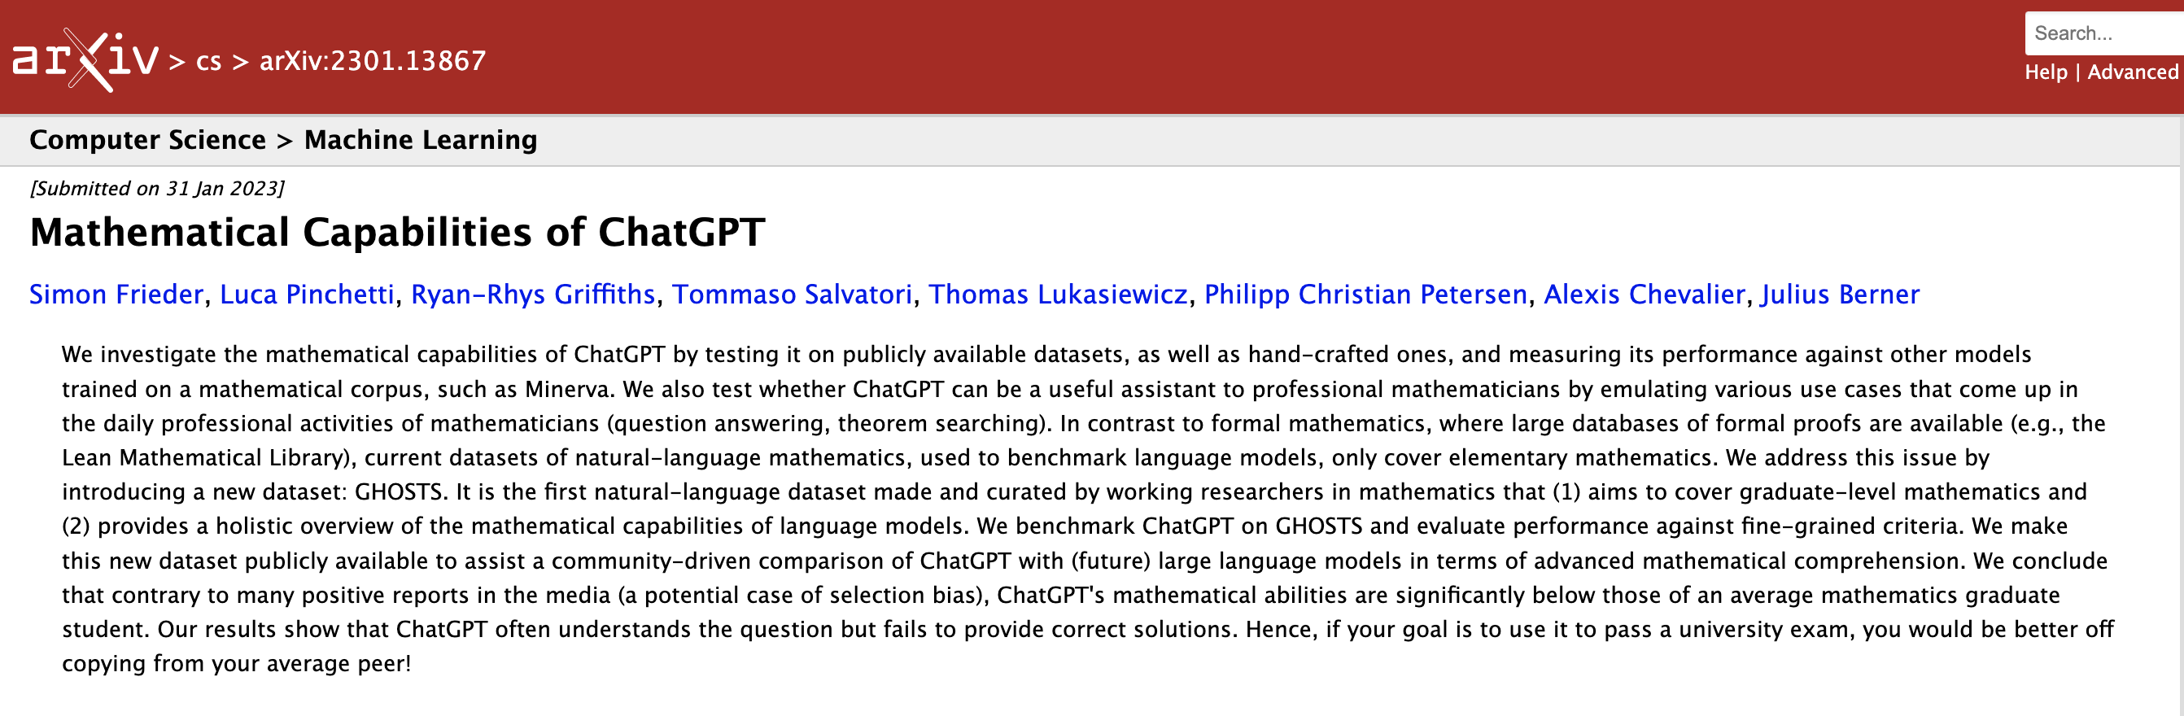

Slide 15
Numerous areas of intersection of AI with academia
Doing science- pattern recognition, data analysis, CNN, etc.
Research on the foundations and optimal applications of AI/ML
Specific applications of ChatGPT-like large language models:
  Generation of narrative text, which impacts:
    Process of our selection of students
    Competency assessment-by-proxy using homework, papers, take-home exams…
  Authorship of scientific papers
  Assessment of proofs in mathematics
  Generation of code from natural language prompts
  Generation of analytic solutions to problems (E&M, QM, circuit analysis…)
Is this a powerful tool to be picked up and used,
and/or an existential threat to elements of higher ed?

Slide 16
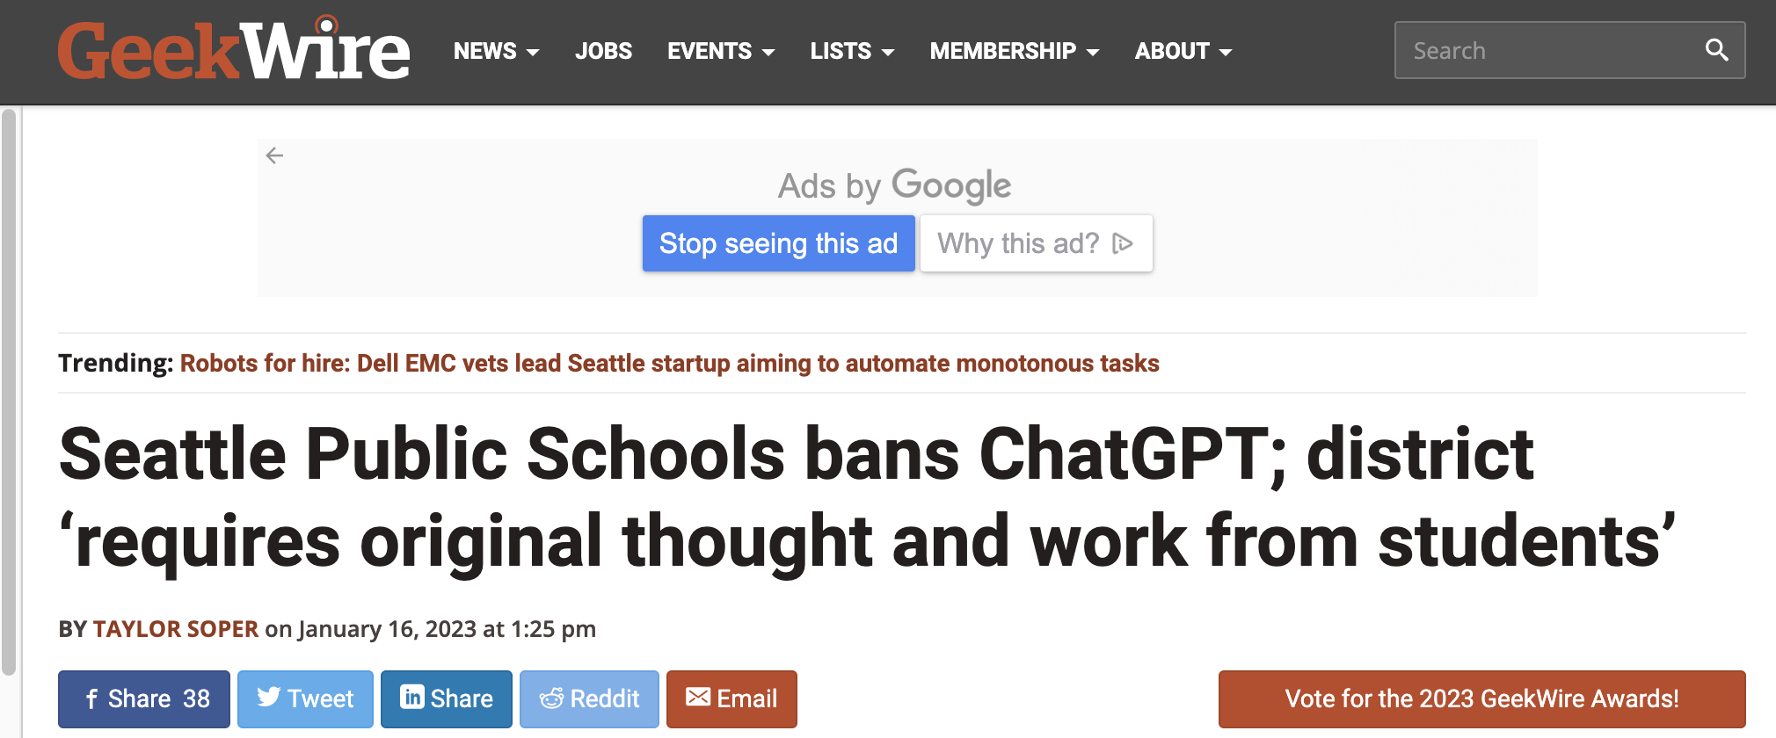
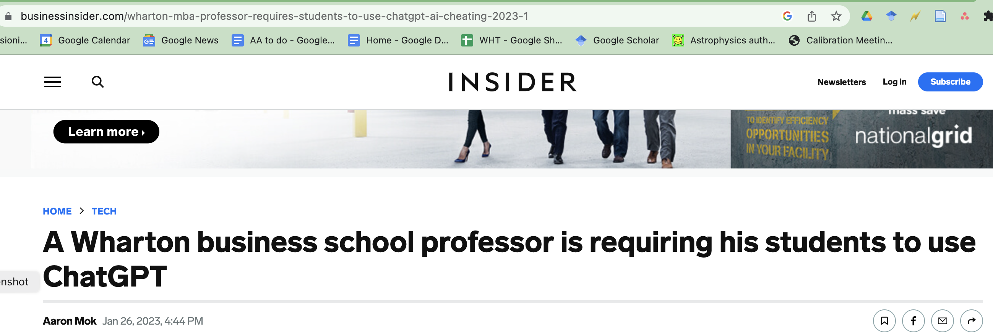
Institutional Responses
Vary Widely
https://www.geekwire.com/2023/seattle-public-schools-bans-chatgpt-district-requires-original-thought-and-work-from-students/
https://www.businessinsider.com/wharton-mba-professor-requires-students-to-use-chatgpt-ai-cheating-2023-1

Slide 17
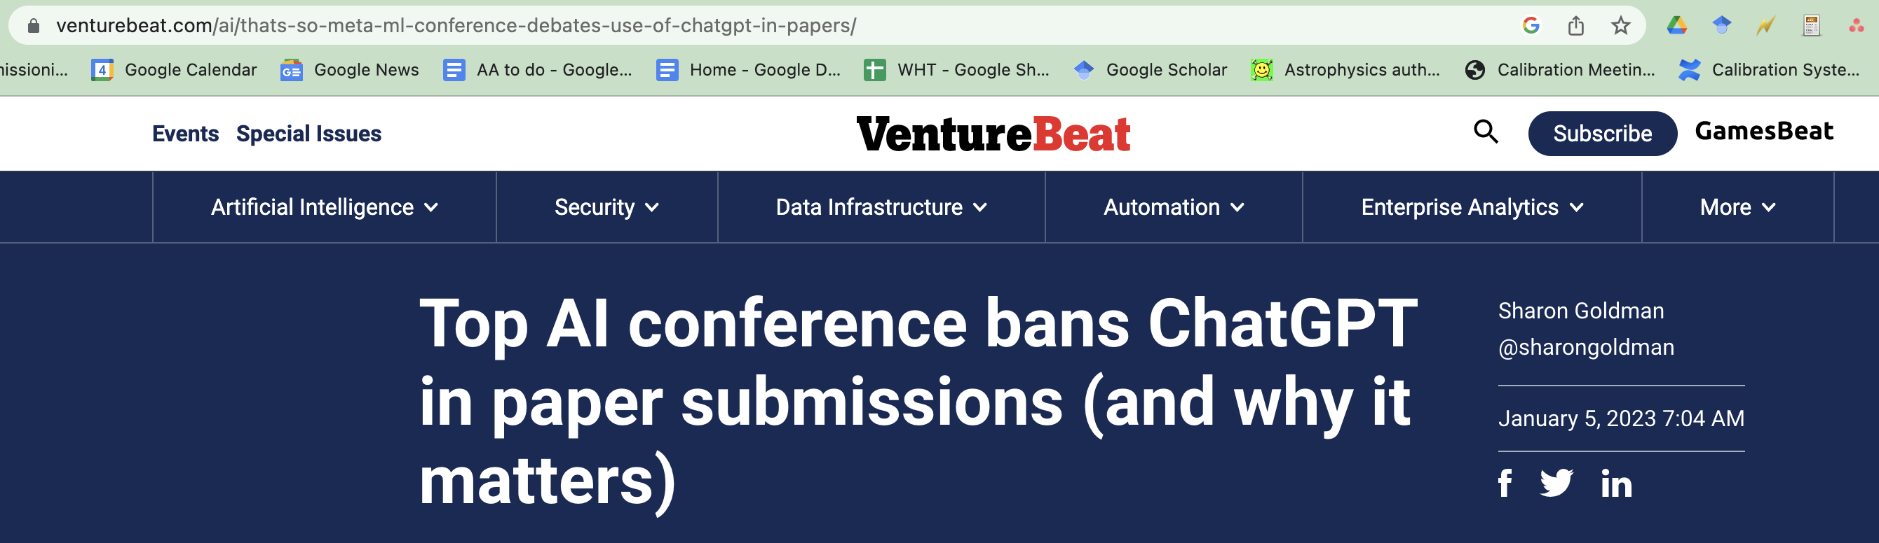
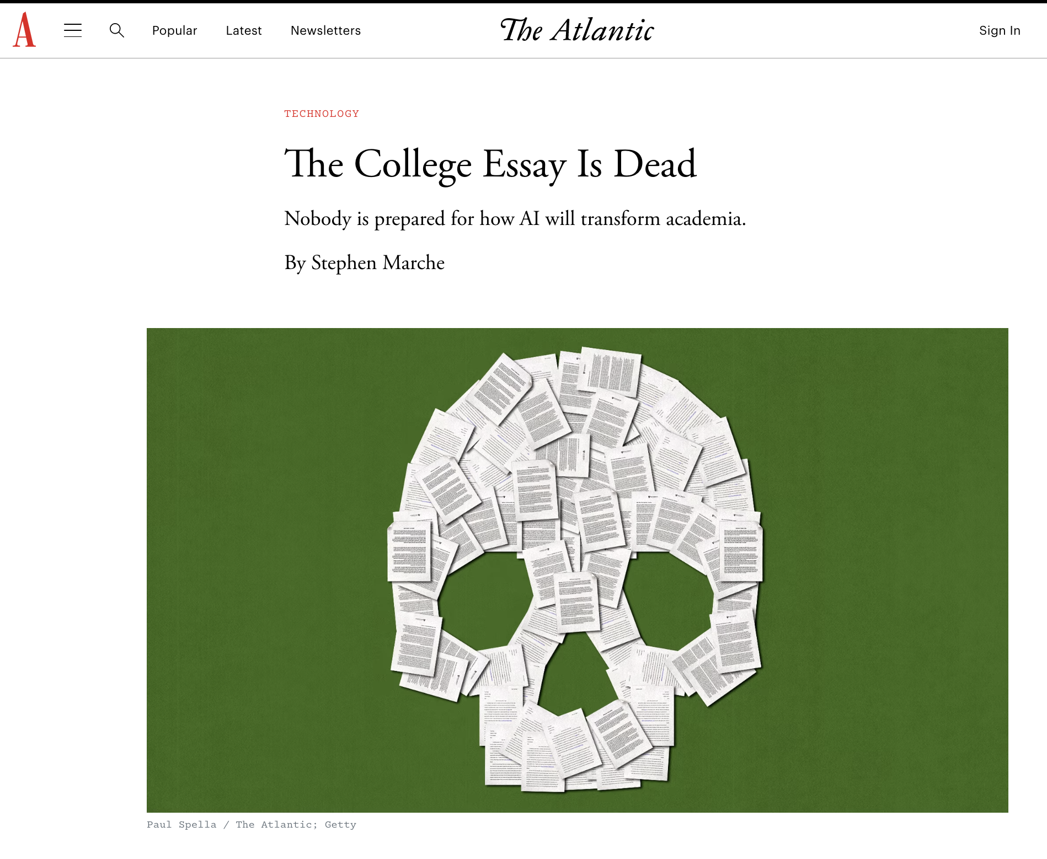
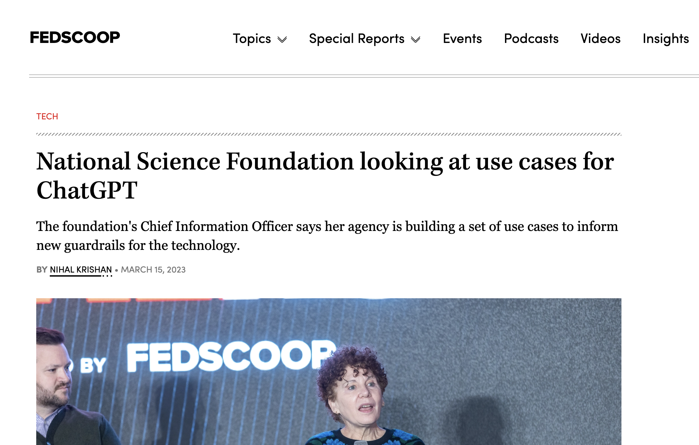
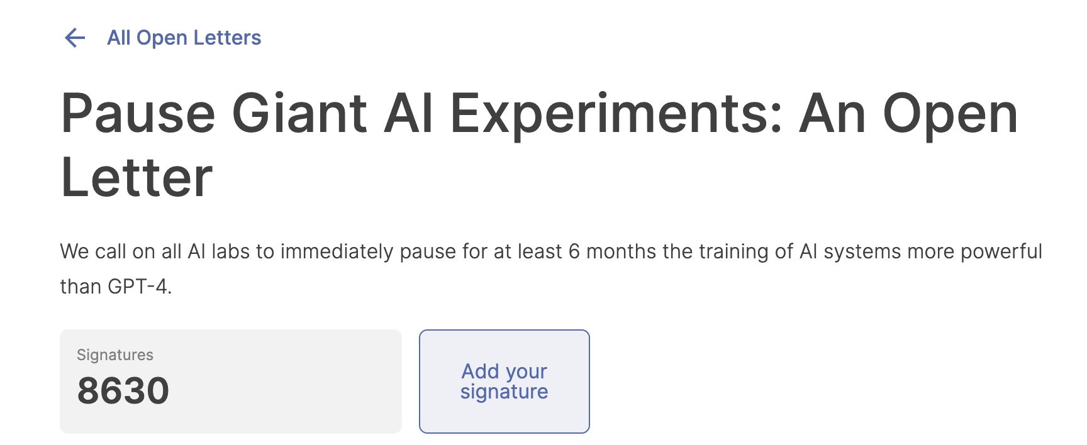

Slide 18
AI-generated content in papers- authorship policies vary
Science magazine
Text generated from AI, machine learning, or similar algorithmic tools cannot be used in papers published in Science journals.... In addition, an AI program cannot be an author of a Science journal paper. A violation of this policy constitutes scientific misconduct.
Nature
Large Language Models (LLMs), such as ChatGPT, do not currently satisfy our authorship criteria. Notably an attribution of authorship carries with it accountability for the work, which cannot be effectively applied to LLMs. Use of an LLM should be properly documented in the Methods section (and if a Methods section is not available, in a suitable alternative part) of the manuscript.
PNAS
According to PNAS and PNAS Nexus policies, if AI software such as ChatGPT has been used to help generate any part of the work it must be clearly acknowledged; it must be noted in the Materials and Methods section (or Acknowledgments, if no Materials and Methods section is available) on submission. The software cannot be listed as an author because it does not meet the criteria for authorship and cannot share responsibility for the paper or be held accountable for the integrity of the data reported.

Slide 19
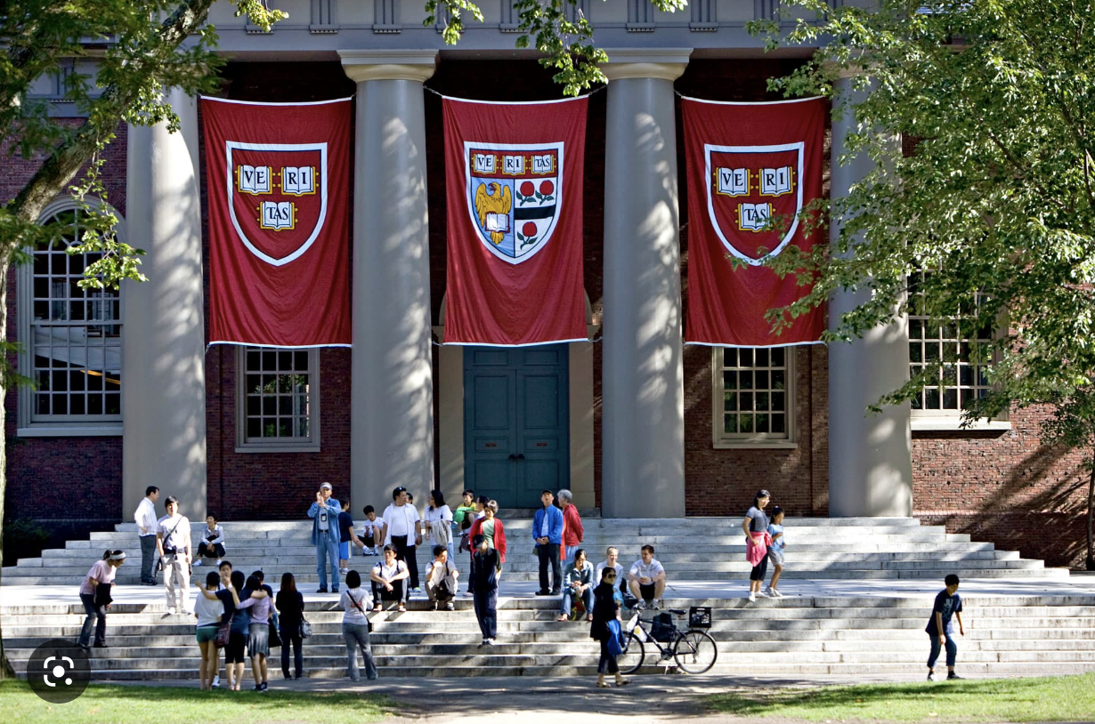
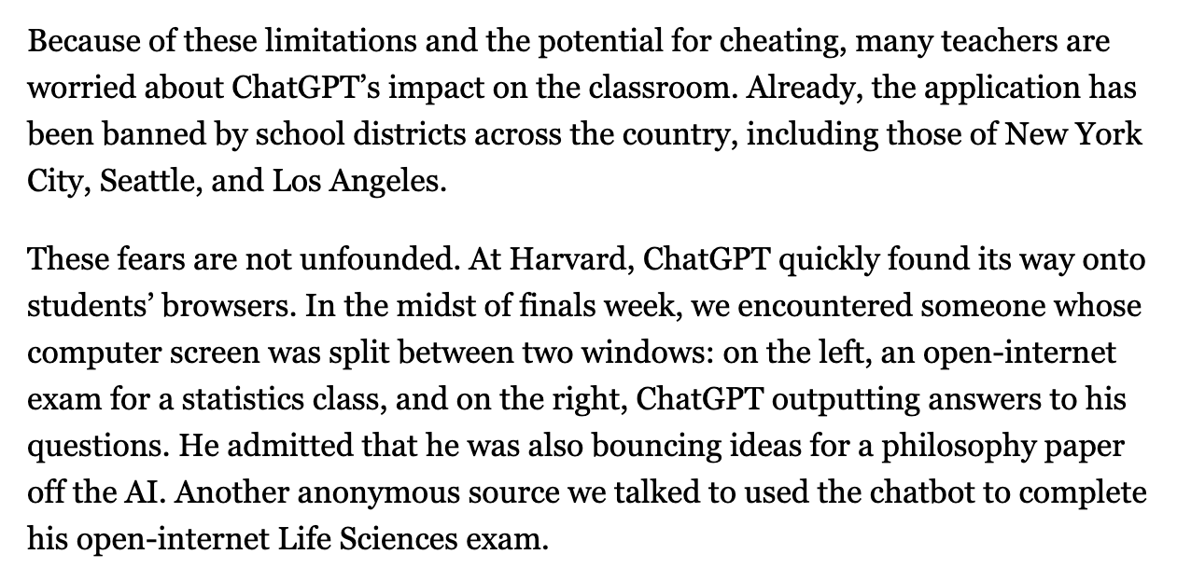
Meanwhile, at Harvard….
Excerpt from https://www.thecrimson.com/article/2023/2/23/chatgpt-scrut/

Slide 20
Some observations
This is a disruptive, rapidly evolving technology with broad ramifications and tremendous upside potential.
This will impact all jobs that involve coding, writing, editing, information harvesting…
Our students are using it, now.
The ethical challenges are non-trivial.
Higher ed response (adapting, setting policies, assisting students…) isn’t keeping up.
Each of us needs to assess and anticipate how to best
  Adapt to
  Accommodate
  Incorporate
  Exploit
  Innovate with
  Regulate
  Evaluate
generative AI tools in our courses, in our mentoring, in our research and service work, and in our selection and assessment of students.

Slide 21
Some issues that warrant your consideration
Which of the following constitute an appropriate use of generative AI tools like Chat-GPT?
  Generation of citation lists based on iterative prompts?
  Generation of text that is incorporated into papers?
  Generation of numerical results based on GPT-produced code?
  Invoking GPT as an AI-interviewer for job candidates?
  Performing a ranked evaluation of graduate application narratives?
  Generation of course syllabus and lecture notes?
  Automated grading of student work?
  Producing a letter of recommendation for an undergraduate based on their CV?
  Generation of PhD dissertation text?
  Writing the narrative for a proposal?
  AI-assisted review of proposals and papers?
For the narrative content of applications (undergrad, graduate, postdocs, staff, faculty, awards…) should we ask whether AI tools were used? If so, how would we validate the responses?
Or do we not care?
What are the ethical considerations and potential unintended consequences of this technology?

Slide 22
Some questions for today’s discussion, focused on educational aspects
How does this technology intersect with a liberal arts education? How can we help our students become
AI-literate and humane, ethical users of these tools?
Many Harvard students feel they are under extreme time pressure. How can we address the seductive attraction of using AI tools as a time-efficient way to generate homework solutions and term papers, and for take-home exams?
How do these short-cuts impact learning? What evidence exists?
How can we incentivize the deeper understanding that comes from wrestling with the material?
How can we best assess student competencies in the things that we really care about?
What are the ethical considerations for our educational mission and for student conduct expectations?
What constitutes “original work”? How will intellectual property and ownership policies evolve?
How, if at all, should we establish institutional policies? What should they be?
How should we contend with a cohort of students (both undergraduate and graduate) who will soon be entering Harvard addicted to this technology?
What are the upside opportunities for AI-empowered learning and improved student experiences?
  Automated tutorials
  Adaptive assessments
  Adaptive assignments
  Advising enhancements
  Focus on higher-level thinking
  Enhancing numerical and quantitative proficiency
Break here for conversation

Slide 23
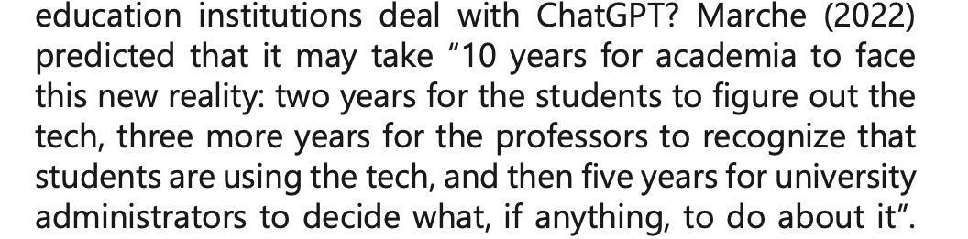
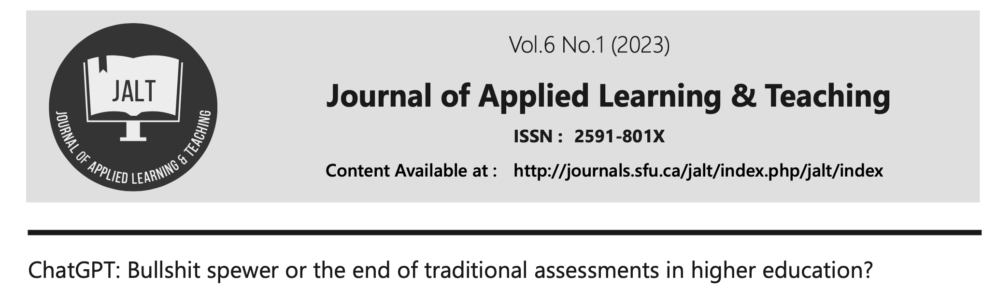
Let’s not end up here.
We need to move on this.
Next slides suggest
Actions for individual faculty
Actions for us as a group
From:

Slide 24
Suggested individual next-steps for increasing your familiarity
Establish an account and play around. https://chat.openai.com
Engage in a discussion with your research group about using this tool.
Talk with undergraduates, grad students, colleagues, and postdocs.
Be sure that you adhere to publication requirements and evolving professional ethical standards.
Anticipate the use of generative-AI in preparation of PhD dissertations. What will we do?
Evaluate the extent to which you would benefit from being a power user.
Stay abreast of this fast-moving and very interesting area, both for scholarship and learning/teaching.
Read this Crimson article: https://www.thecrimson.com/article/2023/2/23/chatgpt-scrut/

Slide 25
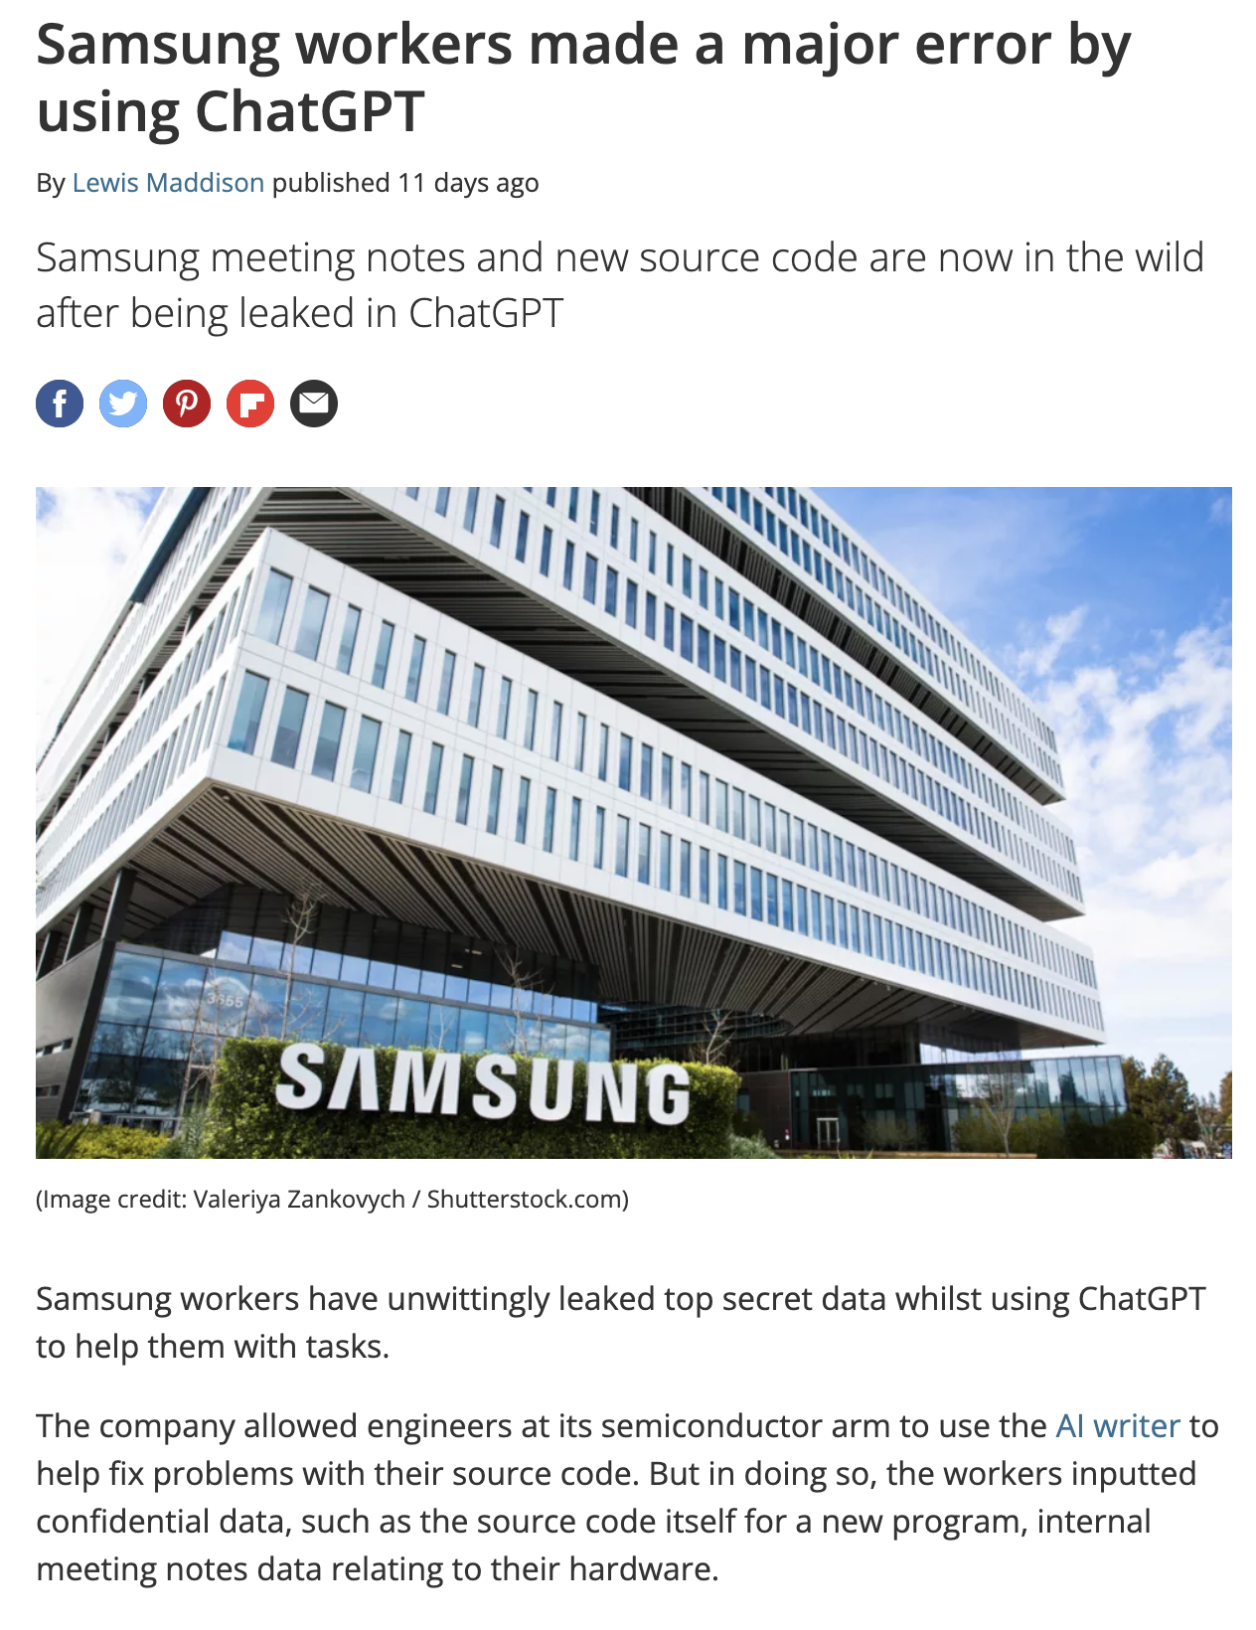
As with all computing technology, you should not expect privacy.
https://www.techradar.com/news/samsung-workers-leaked-company-secrets-by-using-chatgpt
Break here for conversation

Slide 26
It’s essential that we prepare for AY 23-24
Assess how this technology will impact your courses.
  Assume our students will be using these tools effectively.
  Feed HW and exam problems from your courses into AI tools and see what happens.
Adjust your course structure, assessments, grade weighting, and policies as appropriate.
  Ensure learning goals for your course are clear, to both you and the students
  Think carefully about how to best achieve these learning goals, in a generative-AI world
    Explicitly incorporate generative-AI aspects into course structure, assignments, and assessments?
    Incorporate these higher-level tools as a final instructional layer, once foundations are laid?
    Do some instructional experiments in your classes?
    Incorporate into active learning exercises?
    In-class quizzes?
    In-person final exam?
Establish and communicate (in syllabus, in class, on Canvas, on assignments, and on exams) a clear class policy about the use of AI tools.

Slide 27
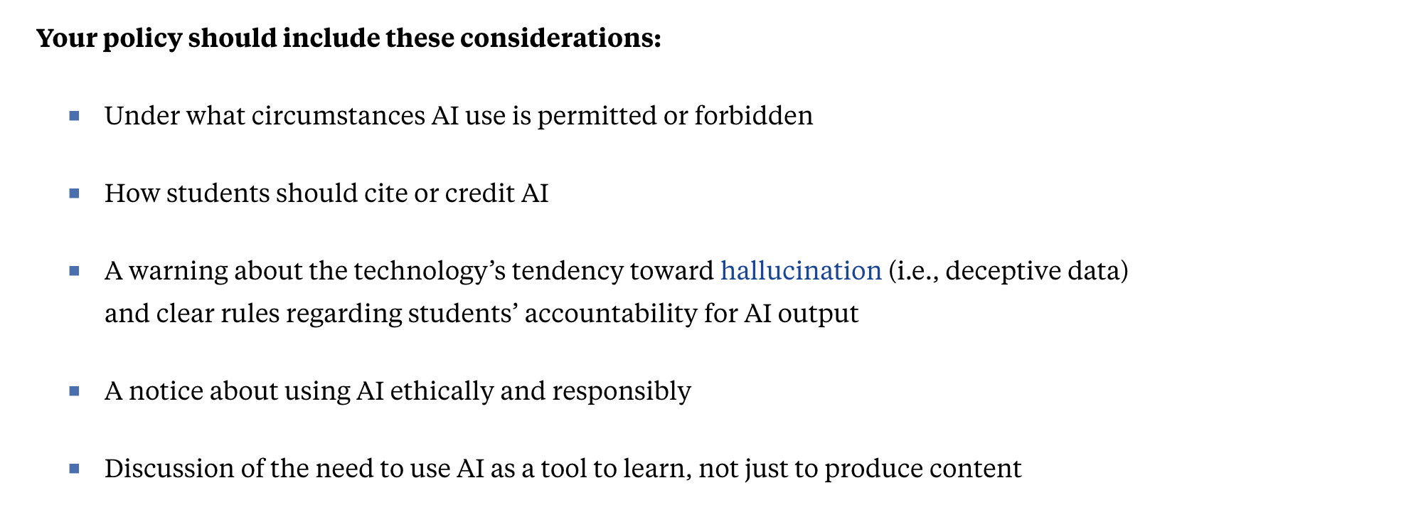
Establish & disseminate a generative-AI course policy
https://hbsp.harvard.edu/inspiring-minds/why-all-our-classes-suddenly-became-ai-classes

Slide 28
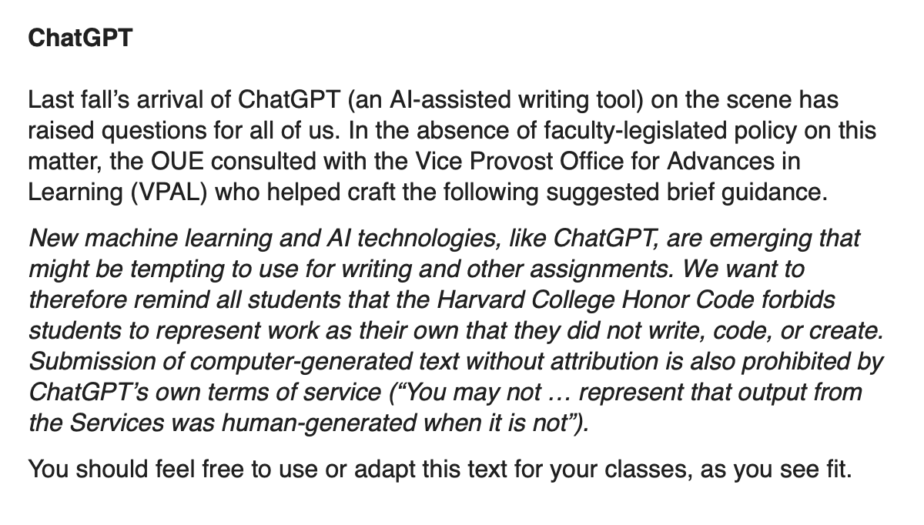
From our Dean of Undergraduate Education
Email to FAS faculty, Jan 20, 2023

Slide 29
Suggested next steps for faculty community-action
How does this impact a liberal arts undergraduate education? How about graduate education?
We should deconstruct our entire instructional model, which includes
In-class instruction
Sections
Laboratories
Preparatory readings and exercises
Homework
Tutorials
What are the high-level goals, strengths, and weaknesses for each of these instructional elements?
How can we leverage generative-AI, and its rapid evolution, to achieve our goals?
How can we assist students in becoming skeptical, proficient, ethical users?
How can we incorporate generative-AI into improving quantitative reasoning and computational competence?
Exams and quizzes
Oral presentations
Written assignments
Numerical assignments
Hands-on participatory learning, including research experiences
….

Slide 30
One possible approach:
Establish a STEM working group* on generative-AI with a focus on pedagogy, charged to:
1) Articulate grounding principles, e.g.
  Competence comes from extended intellectual engagement
  Before turning to Chat-GPT to generate code, need to be able to do it yourself
  Validation and verification are essential ….
2) Establish high-level STEM learning goals that pertain to generative-AI tools, e.g.
  Upon graduation, students will be thoughtful, ethical, proficient users of …
3) Define a first phase of instructional experimentation, where AI tools are used in large lectures, in small-group settings, in lab settings, etc. Should we initiate a Gen Ed course in the use of Chat-GPT across liberal arts topics?
4) Propose ways to adapt our graduate student, staff, postdoc, and faculty selection processes to this new reality.
5) Consider how we can maintain academic integrity, in particular for student assessments and for dissertations.
*STEM Committee for Education with Large LanguageModels = STEM CELL?

Slide 31
Some resources and references
(GPT-4 technical report)
Technical
Impact
Institutional Policies
Good overview from Harvard student perspective
https://arxiv.org/abs/2303.08774
https://arxiv.org/abs/2206.14858# (paper on quantitative reasoning, Minerva rather than Chat-GPT)
https://hbsp.harvard.edu/inspiring-minds/chatgpt-and-ai-text-generators-should-academia-adapt-or-resist
https://hbsp.harvard.edu/inspiring-minds/why-all-our-classes-suddenly-became-ai-classes
https://prodev.illinoisstate.edu/pedagogy/ai/
https://www.bu.edu/cds-faculty/culture-community/conduct/gaia-policy/ (BU’s generative AI policy)
https://www.thecrimson.com/article/2023/2/23/chatgpt-scrut/ (Crimson article)

Slide 32
Some resources and references
https://openai.com/customer-stories/khan-academy
https://openai.com/customer-stories/duolingo
https://www.newyorker.com/tech/annals-of-technology/chatgpt-is-a-blurry-jpeg-of-the-web?utm_source=onsite-share&utm_medium=email&utm_campaign=onsite-share&utm_brand=the-new-yorker
Interactive Instruction
Nice overview article in New Yorker, including why arithmetic doesn’t work well.

